Slide 1
Local footprint maps.
Replace slide 11 in fiber sales deck with your area map.
2. Albany
3. Atlanta
4. Boston
5. Brooklyn
6. Chicago
7. Cincinnati
8. Cleveland
9. Columbus
10. Dayton
11. Delaware
12. Detroit
13. Florida
26. Pittsburgh
27. Rhode Island
28. Tampa
29. Washington, DC
30. Wilmington
14. Greater Miami
15. Greater Tampa
16. Houston
17. Jacksonville
18. Los Angeles
19. SoCal
20. Long Island
21. Massachusetts
22. Miami
23. New York metro
24. Orlando
25. Philadelphia

Slide 2
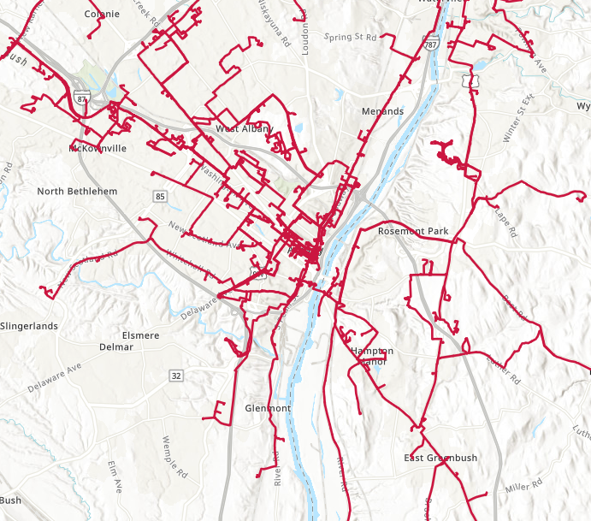
Your local footprint: Albany.

Slide 3
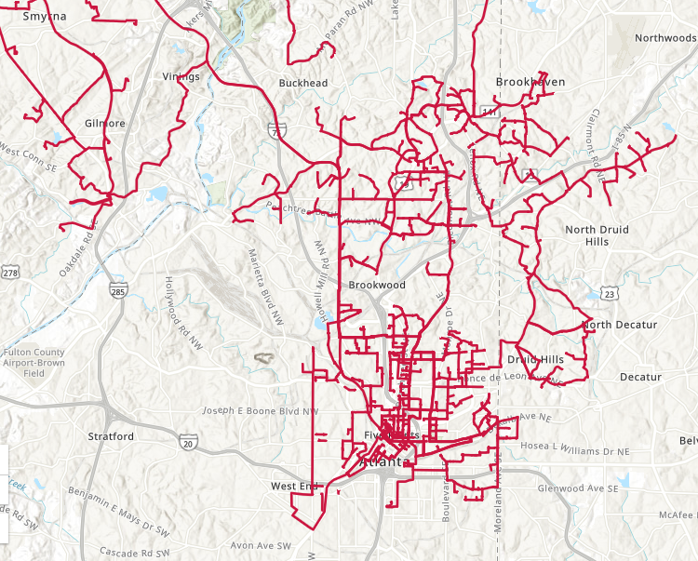
Your local footprint: Atlanta.

Slide 4
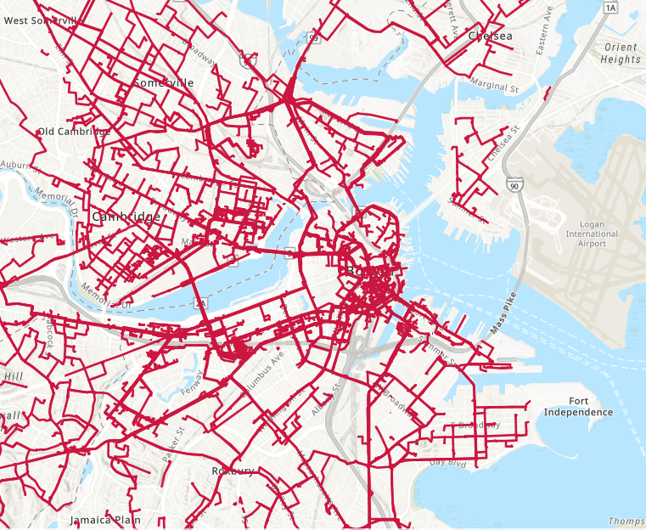
Your local footprint: Boston.

Slide 5
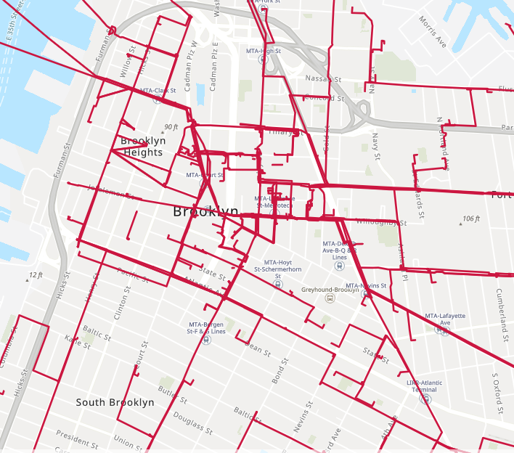
Your local footprint: Brooklyn.

Slide 6
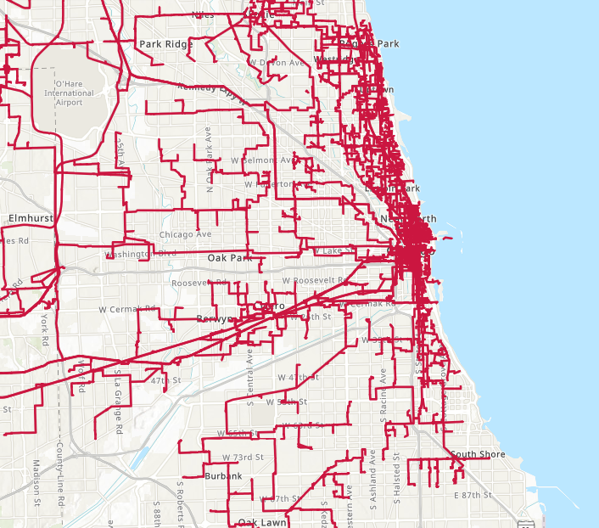
Your local footprint: Chicago.

Slide 7
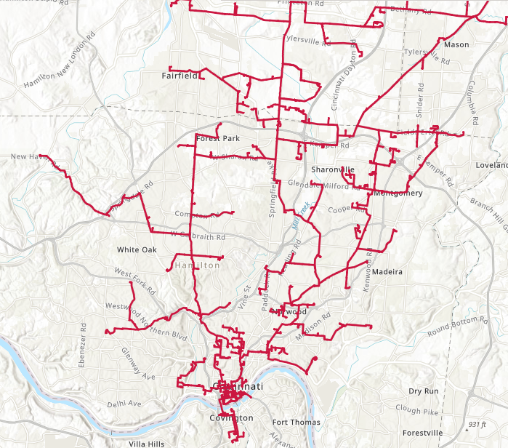
Your local footprint: Cincinnati.

Slide 8
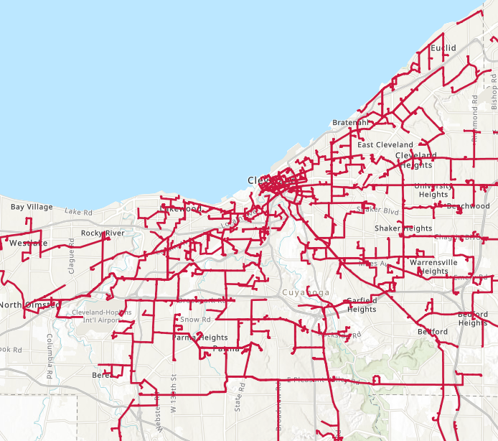
Your local footprint: Cleveland.

Slide 9
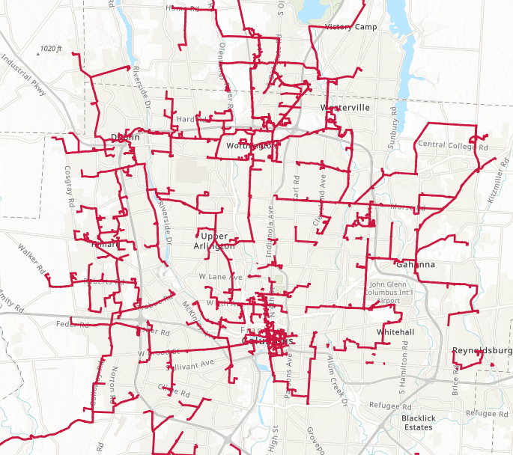
Your local footprint: Columbus.

Slide 10
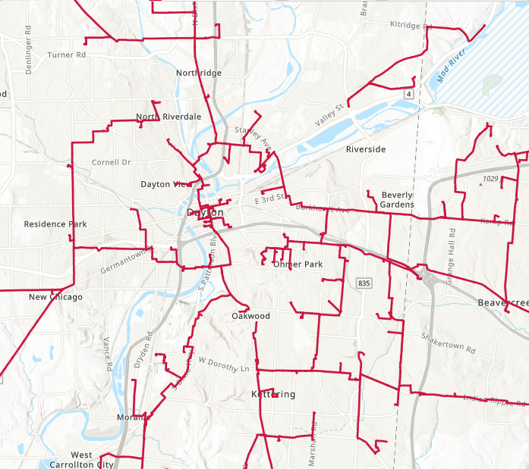
Your local footprint: Dayton.

Slide 11
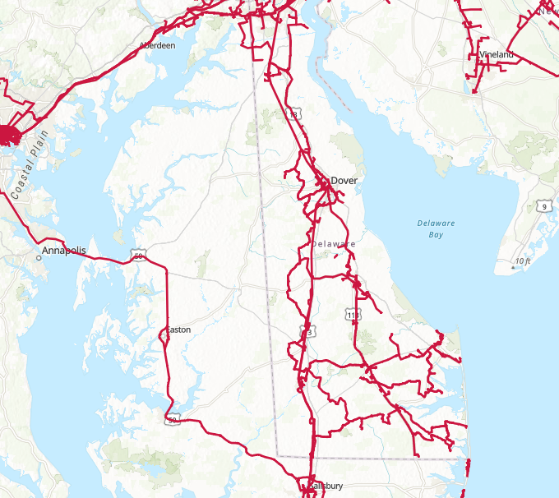
Your local footprint: Delaware.

Slide 12
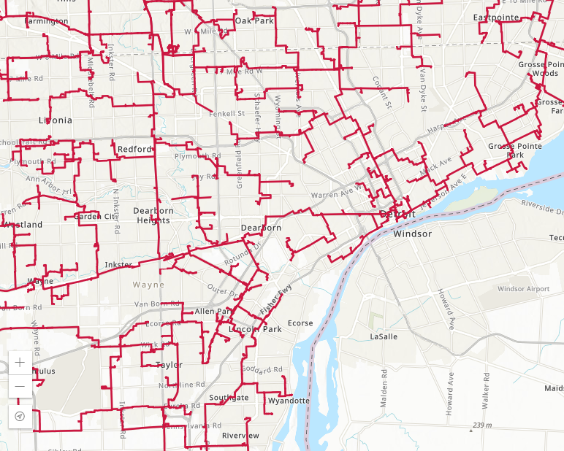
Your local footprint: Detroit.

Slide 13
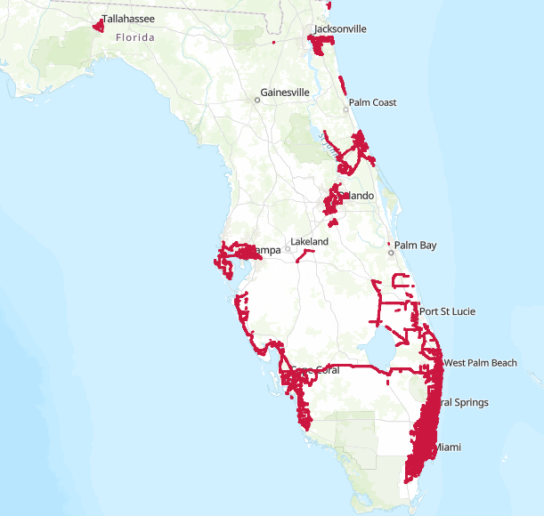
Your local footprint: Florida.

Slide 14
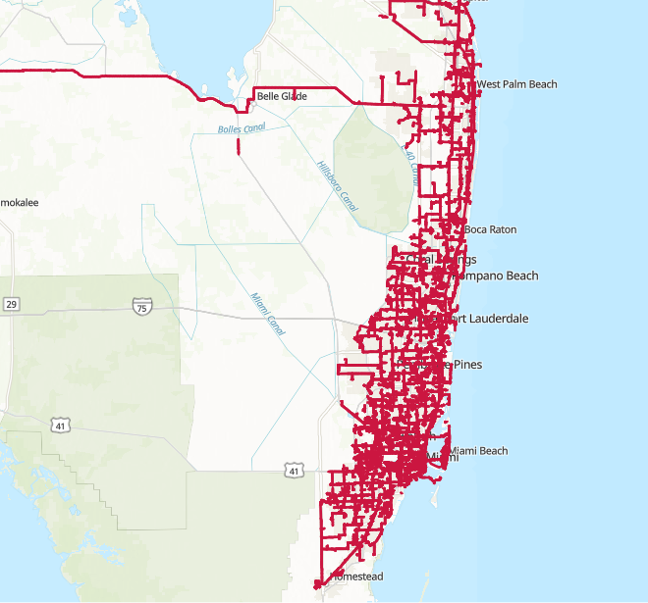
Your local footprint: Greater Miami.

Slide 15
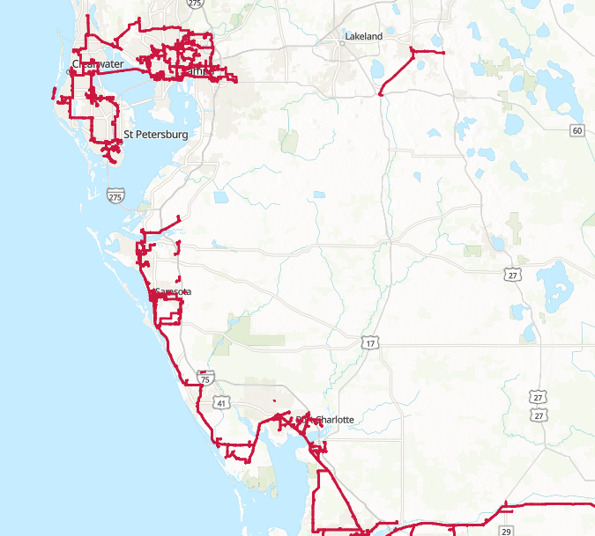
Your local footprint: Greater Tampa.

Slide 16
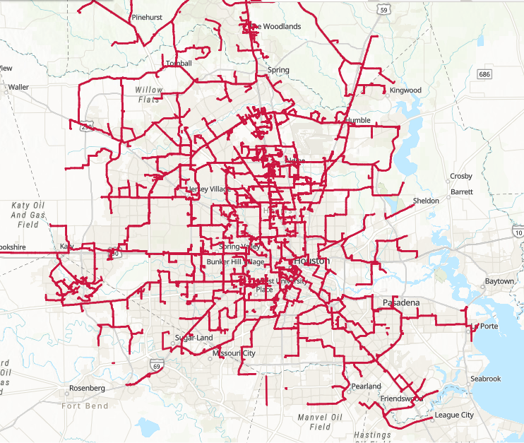
Your local footprint: Houston.

Slide 17
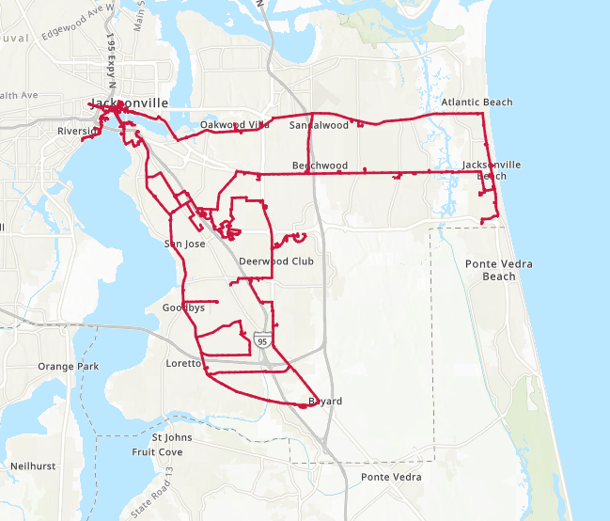
Your local footprint: Jacksonville.

Slide 18
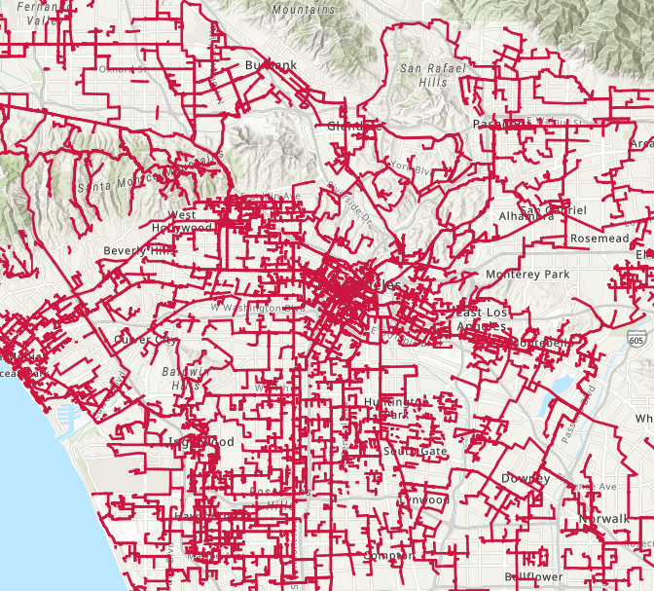
Your local footprint: Los Angeles.

Slide 19
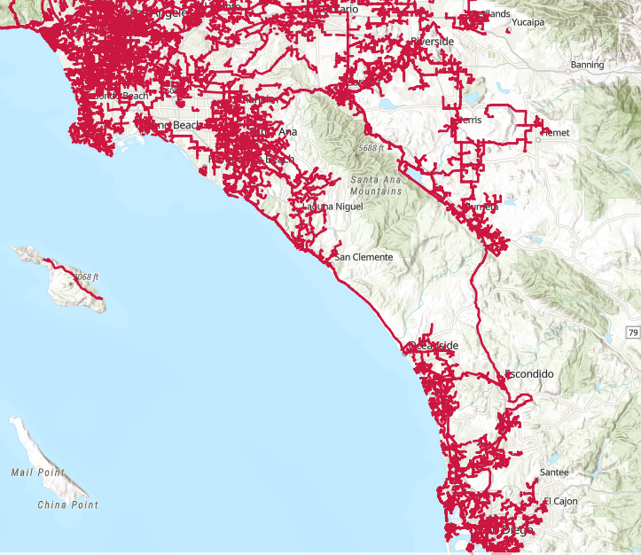
Your local footprint: SoCal.

Slide 20
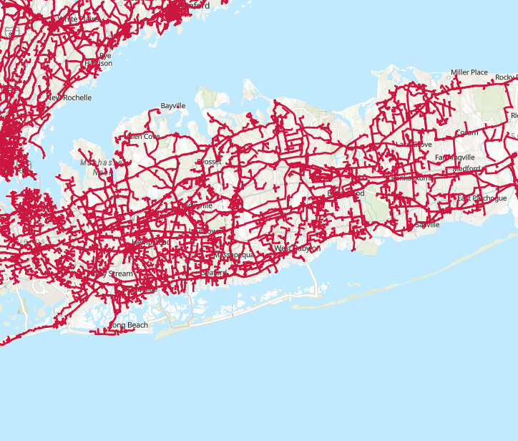
Your local footprint: Long Island.

Slide 21
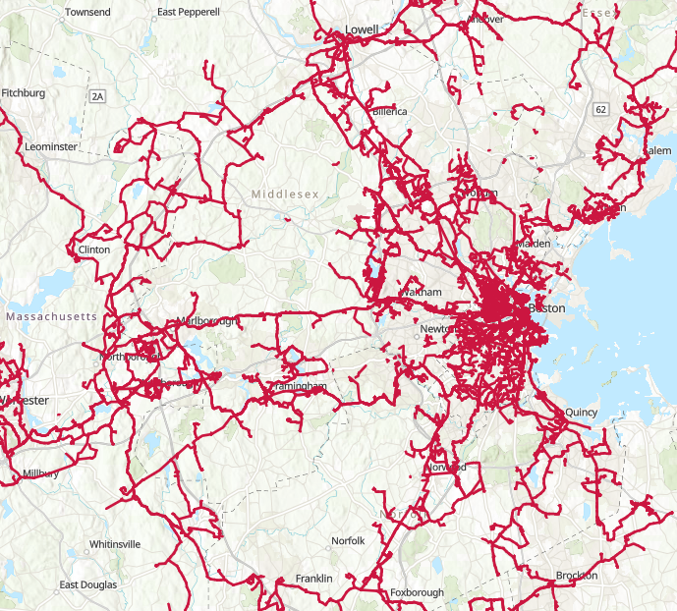
Your local footprint: Massachusetts.

Slide 22
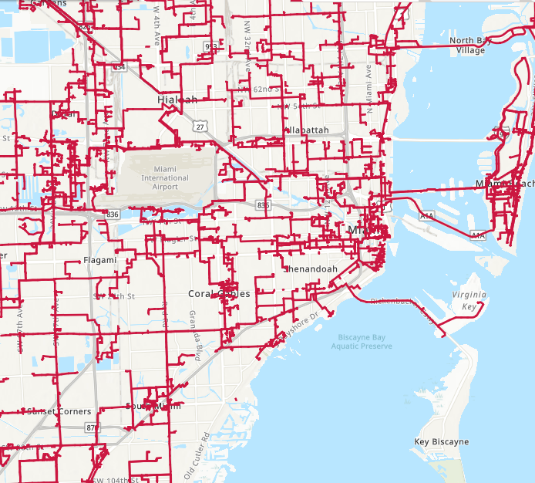
Your local footprint: Miami.

Slide 23
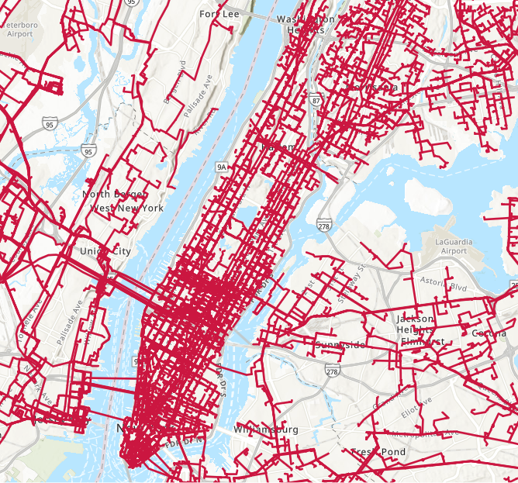
Your local footprint: New York metro.

Slide 24
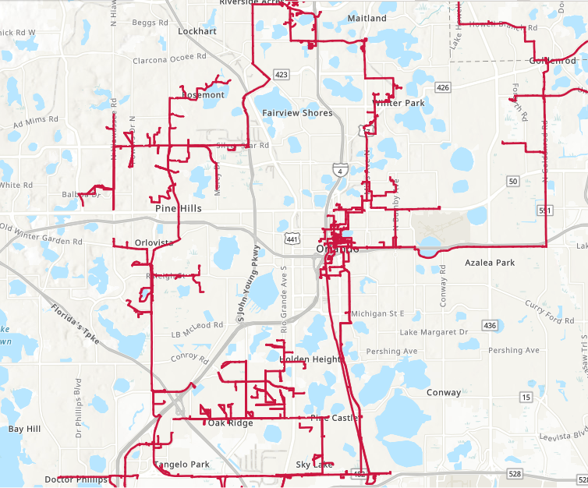
Your local footprint: Orlando.

Slide 25
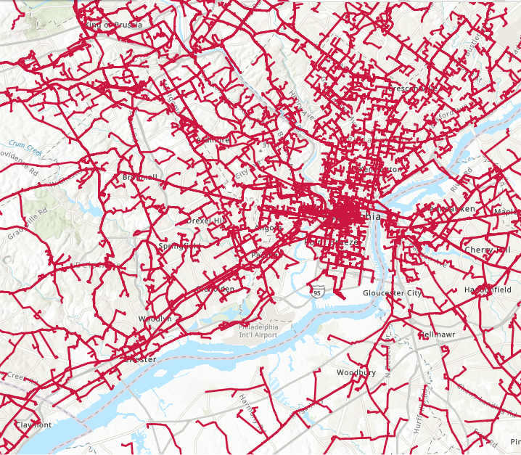
Your local footprint: Philadelphia.

Slide 26
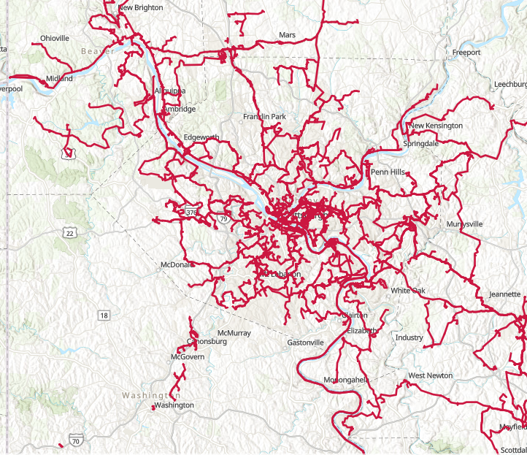
Your local footprint: Pittsburgh.

Slide 27
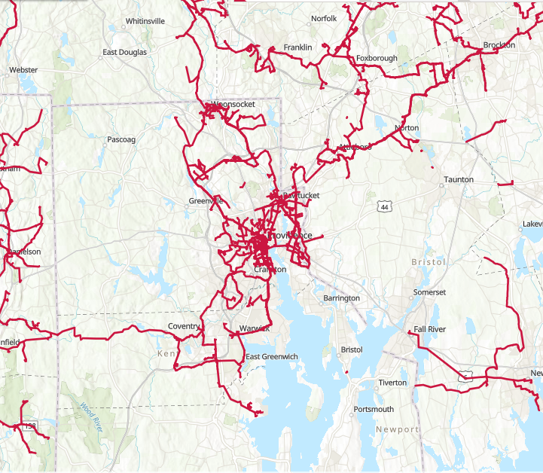
Your local footprint: Rhode Island.

Slide 28
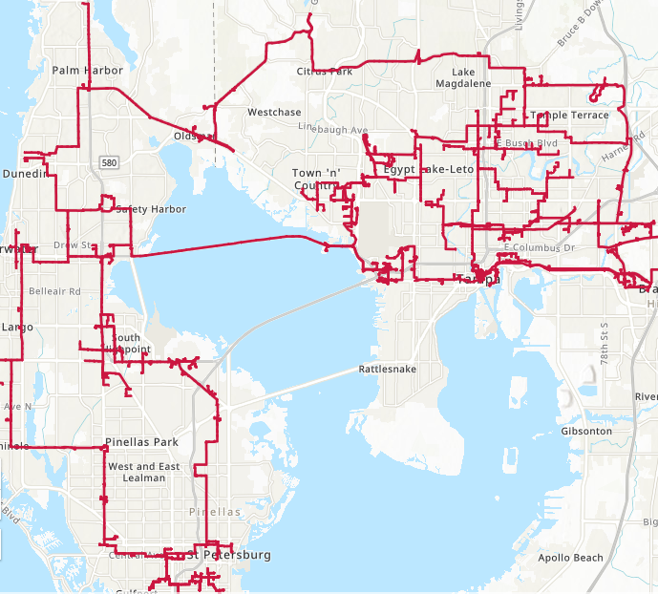
Your local footprint: Tampa.

Slide 29
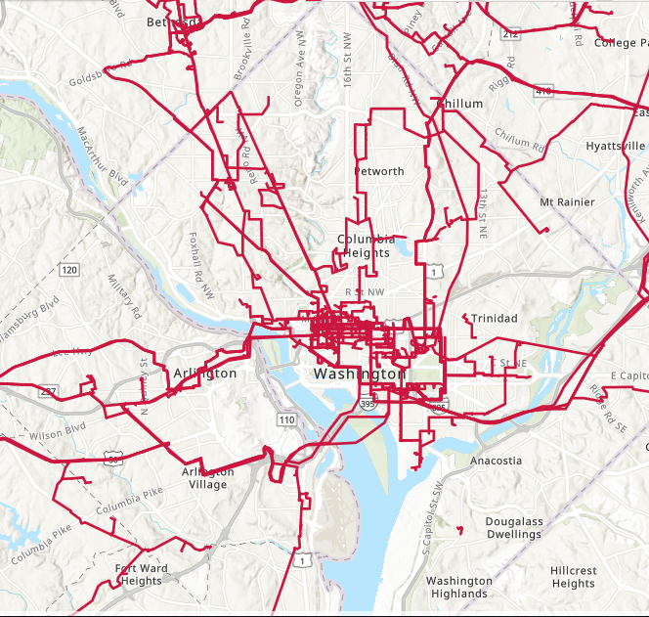
Your local footprint: Washington, DC.

Slide 30
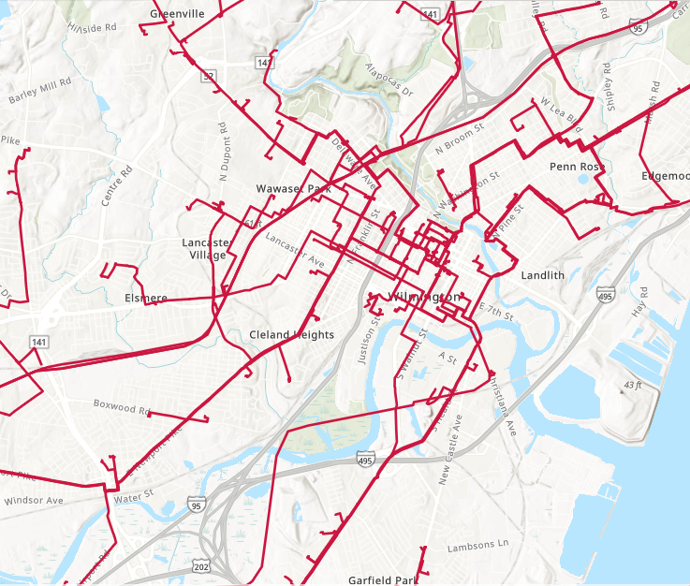
Your local footprint: Wilmington.

Slide 31
Product details.
Add to the fiber sales deck based on customer needs.
32. Dark Fiber
33. Wavelength
34. Ethernet
35. Managed Private Optical Network (MPON) 36. Managed SD-WAN
37. Internet Access
38. Cloud Services
39. Colocation
40. Optical Encryption
41. Video Transport 42. DDoS Defense Solution
43. Additional Solutions

Slide 32
Dark Fiber
Key benefits
Full access to approximately 80,000 route miles of fiber
32,000+ on-net buildings
900+ connected data centers, PoPs, and COs
Multi-site designs customized for you
Access to unique fiber assets, routes and secure rights-of-way
More than 25 years of experience building and maintaining fiber networks for over 9,000 customers
Locally based service teams are available to you whenever you need them
Features
Control: Design, build and plan the evolution of your own network while managing budget and project costs according your business growth. You have the freedom to select technologies and equipment used, on your timeline.
Security: With private physical network infrastructure on your own dedicated strands of fiber, you can maximize your security.
Scalability: With unlimited bandwidth capabilities you have the ability to easily scale your network depending on the needs of your organization.
Notes:
No matter who your prospect is talking to, coach them on the questions they should be asking other providers. There are disadvantages to choosing a network partner that can’t deliver on these points. Do they offer the connectivity needed? Do they control their network assets (e.g., the last mile), do they offer strong SLAs backed by local market support. Are they interested in asking questions and listening to pain points and needs to design the right solution at the right time?
Questions refer to our product, network, and people strengths:
Connectivity – Last owner of our network. Network density and reach with approximately 80,000 route miles of fiber, over 32,000 on-net buildings, and more than 900 connected data centers, PoPs, and COs. Robust product portfolio with customizable solutions.
Performance – Secure, scalable solutions backed by strong SLAs and local resources.
Partnership – Consultative sales approach to deliver the right solutions. In-market and industry expertise with solution design, implementation and maintenance regardless of the business or organization type.

Slide 33
Wavelength
Key benefits
Speeds from 1Gbps to 100Gbps
Dedicated bandwidth at full line rate
Flexible, transparent bandwidth that supports most major protocols
Unprotected or protected configurations designed to your specific needs
Standard or customized diverse fiber paths and low latency routes available
Dedicated bandwidth to your cloud provider
Managed Private Optical Networks delivered over private fiber and dedicated WDM equipment
Features
Speed and capacity: Transfer large amounts of data at speeds between 1Gbps and 100Gbps at full line rate without traffic congestion.
Security: Dedicated wavelengths protect your data and optical encryption is available to help meet regulatory requirements.
Availability: Standard wavelengths offer SLAs of 99.9% and are customizable to protect against all single points of failure up to 99.999%.
Notes:
No matter who your prospect is talking to, coach them on the questions they should be asking other providers. There are disadvantages to choosing a network partner that can’t deliver on these points. Do they offer the connectivity needed? Do they control their network assets (e.g., the last mile), do they offer strong SLAs backed by local market support. Are they interested in asking questions and listening to pain points and needs to design the right solution at the right time?
Questions refer to our product, network, and people strengths:
Connectivity – Last owner of our network. Network density and reach with approximately 80,000 route miles of fiber, over 32,000 on-net buildings, and more than 900 connected data centers, PoPs, and COs. Robust product portfolio with customizable solutions.
Performance – Secure, scalable solutions backed by strong SLAs and local resources.
Partnership – Consultative sales approach to deliver the right solutions. In-market and industry expertise with solution design, implementation and maintenance regardless of the business or organization type.

Slide 34
Ethernet
Key benefits
Speeds from 1Gbps to 100Gbps
Dedicated bandwidth at full line rate
Flexible, transparent bandwidth that supports most major protocols
Unprotected or protected configurations designed to your specific needs
Standard or customized diverse fiber paths and low latency routes available
Dedicated bandwidth to your cloud provider
Managed Private Optical Networks delivered over private fiber and dedicated WDM equipment
Switched Ethernet core provides resilient, high-availability transport services
Available in switched or dedicated service options
Flexible configurations
E-Line: Point-to-point private line
EVPL: Point-to-point or point-to-multipoint
E-LAN: Multipoint-to-multipoint
Metro-E Advanced Private Line: private fiber over dedicated equipment
Multiple access protection options
24/7 network surveillance and monitoring
Numerous cloud access points for Amazon Web Services, Google, Microsoft Azure and other Cloud Service Providers
Features
Features
Resiliency: Nationwide MPLS core routes traffic via the best available path directing packets around outages and congestion.
Scalability: WAN connectivity from 10Mbps to 100Gbps with guaranteed network performance.
Flexibility: Our dense network infrastructure allows for multiple entrances and diverse fiber routes.
Notes:
No matter who your prospect is talking to, coach them on the questions they should be asking other providers. There are disadvantages to choosing a network partner that can’t deliver on these points. Do they offer the connectivity needed? Do they control their network assets (e.g., the last mile), do they offer strong SLAs backed by local market support. Are they interested in asking questions and listening to pain points and needs to design the right solution at the right time?
Questions refer to our product, network, and people strengths:
Connectivity – Last owner of our network. Network density and reach with approximately 80,000 route miles of fiber, over 32,000 on-net buildings, and more than 900 connected data centers, PoPs, and COs. Robust product portfolio with customizable solutions.
Performance – Secure, scalable solutions backed by strong SLAs and local resources.
Partnership – Consultative sales approach to deliver the right solutions. In-market and industry expertise with solution design, implementation and maintenance regardless of the business or organization type.

Slide 35
Managed Private Optical Network (MPON)
Key benefits
Private fiber, equipment and monitoring are fully dedicated to each customer
Optional, FIPS-certified, Layer 1, optical encryption protects data in flight
Private networks can use new technologies to meet your specifications
Leverages proven processes and experience with equipment and vendors reducing your overall technical risk
One call resolves any fiber, equipment or software issues that may occur
Features
Performance: Same full capacity as Dark Fiber, but we design, purchase equipment, configure, test, monitor, and troubleshoot each performance upgrade.
Customizable: Focused on your application and bandwidth needs, we design optimal Dark Fiber routes and equipment for your solution today, with optional built-in upgrades to meet your future needs.
Availability: We provide multiple fiber routes and equipment protection options to give you the uptime you need with a guaranteed SLA.
Notes:
No matter who your prospect is talking to, coach them on the questions they should be asking other providers. There are disadvantages to choosing a network partner that can’t deliver on these points. Do they offer the connectivity needed? Do they control their network assets (e.g., the last mile), do they offer strong SLAs backed by local market support. Are they interested in asking questions and listening to pain points and needs to design the right solution at the right time?
Questions refer to our product, network, and people strengths:
Connectivity – Last owner of our network. Network density and reach with approximately 80,0000 route miles of fiber, over 32,000 on-net buildings, and more than 900 connected data centers, PoPs, and COs. Robust product portfolio with customizable solutions.
Performance – Secure, scalable solutions backed by strong SLAs and local resources.
Partnership – Consultative sales approach to deliver the right solutions. In-market and industry expertise with solution design, implementation and maintenance regardless of the business or organization type.

Slide 36
Managed SD-WAN
Key benefits
Flexible bandwidth, up to 10Gbps
Edge devices and software licenses, supporting up to 10Gbps
Portal access for performance monitoring, utilization reporting, analytics, historical data, and near real-time tools
Support for multiple underlay options including IP, MPLS, or bring-your-own-transport
Add on features for increased reliability:
High availability configurations with redundant paths
Next generation firewall
Features
Network agility: Scale your network based on applications needs and make changes to a site or provision a new location—quickly and nimbly.
Cost-efficient: Reduce your operational expenses and administrative fees with faster deployments that give you increased operational efficiency and free up key IT resources.
Flexibility: A turnkey solution that gives you the visibility and flexibility to meet the bandwidth and security requirements you need and the ability to add network diversity for extra peace of mind.
Security: Highly secure access to your applications designed to work with encrypted connectivity and the option to add additional security features.
Notes:
No matter who your prospect is talking to, coach them on the questions they should be asking other providers. There are disadvantages to choosing a network partner that can’t deliver on these points. Do they offer the connectivity needed? Do they control their network assets (e.g., the last mile), do they offer strong SLAs backed by local market support. Are they interested in asking questions and listening to pain points and needs to design the right solution at the right time?
Questions refer to our product, network, and people strengths:
Connectivity – Last owner of our network. Network density and reach with approximately 80,000 route miles of fiber, over 32,000 on-net buildings, and more than 900 connected data centers, PoPs, and COs. Robust product portfolio with customizable solutions.
Performance – Secure, scalable solutions backed by strong SLAs and local resources.
Partnership – Consultative sales approach to deliver the right solutions. In-market and industry expertise with solution design, implementation and maintenance regardless of the business or organization type.

Slide 37
Internet Access
Key benefits
Robust metro and backbone network infrastructures
Multiple and geographically diverse peering connections ensures reliable access points to the internet
Bandwidth rates from 10Mbps up to 10Gbps
Option to burst above subscribed bandwidth rates when needed
IPv6-compatible, dual stack connection capable
Features
Speed: High-speed fiber optic connection delivered directly to your business, data center or PoP.
Scalability: Increase your bandwidth connection as your business grows.
Reliability: Direct connection to our robust and diverse fiber network, with additional protection options.
Service: Network Operations Center providing proactive traffic monitoring and technical support 24/7—never outsourced.
Notes:
No matter who your prospect is talking to, coach them on the questions they should be asking other providers. There are disadvantages to choosing a network partner that can’t deliver on these points. Do they offer the connectivity needed? Do they control their network assets (e.g., the last mile), do they offer strong SLAs backed by local market support. Are they interested in asking questions and listening to pain points and needs to design the right solution at the right time?
Questions refer to our product, network, and people strengths:
Connectivity – Last owner of our network. Network density and reach with approximately 80,000 route miles of fiber, over 32,000 on-net buildings, and more than 900 connected data centers, PoPs, and COs. Robust product portfolio with customizable solutions.
Performance – Secure, scalable solutions backed by strong SLAs and local resources.
Partnership – Consultative sales approach to deliver the right solutions. In-market and industry expertise with solution design, implementation and maintenance regardless of the business or organization type.

Slide 38
Cloud Services
Key benefits
Speeds ranging from 10Mbps to 100Gbps
Multiple connectivity options to Amazon Web Services, Google, and Microsoft Azure
Cloud on-ramps throughout the US provide broad geographic coverage
Cloud connectivity via Internet Access, Ethernet, Wavelength available in most areas
Features
Security: Direct Cloud connectivity is available for your sensitive applications, protecting you against the risk of running through the public internet.
Speed and performance: Dedicated connections decrease latency and increase performance of your cloud-based transactions and applications.
Flexibility: Connections can be tailored to your needs with bandwidth ranging from 10Mbps to 100Gbps.
Notes:
No matter who your prospect is talking to, coach them on the questions they should be asking other providers. There are disadvantages to choosing a network partner that can’t deliver on these points. Do they offer the connectivity needed? Do they control their network assets (e.g., the last mile), do they offer strong SLAs backed by local market support. Are they interested in asking questions and listening to pain points and needs to design the right solution at the right time?
Questions refer to our product, network, and people strengths:
Connectivity – Last owner of our network. Network density and reach with approximately 80,000 route miles of fiber, over 32,000 on-net buildings, and more than 900 connected data centers, PoPs, and COs. Robust product portfolio with customizable solutions.
Performance – Secure, scalable solutions backed by strong SLAs and local resources.
Partnership – Consultative sales approach to deliver the right solutions. In-market and industry expertise with solution design, implementation and maintenance regardless of the business or organization type.

Slide 39
Colocation
Key benefits
Scalable space to support cabinets and cages
Designed and maintained to support 100% uptime with back-up generators and fully protected DC power
AC and DC power feeds with redundancy options based on location capabilities
Designed to support various equipment densities
Connectivity to a variety of service providers
Support options including remote and/or smart hands
Multi-tiered controlled access to private space
Features
Speed and performance: Our data centers are strategically positioned within our network to offer optimal speed and redundancy.
Protection: Uninterruptable power supply with N+1 redundancy levels, backup generator systems, and high-power capabilities provide superior protection.
Availability: 24/7 card access to your secure racks, and uninterrupted access to mission-critical applications—even in the event of a power outage at your own facilities.
Notes:
No matter who your prospect is talking to, coach them on the questions they should be asking other providers. There are disadvantages to choosing a network partner that can’t deliver on these points. Do they offer the connectivity needed? Do they control their network assets (e.g., the last mile), do they offer strong SLAs backed by local market support. Are they interested in asking questions and listening to pain points and needs to design the right solution at the right time?
Questions refer to our product, network, and people strengths:
Connectivity – Last owner of our network. Network density and reach with approximately 80,000 route miles of fiber, over 32,000 on-net buildings, and more than 900 connected data centers, PoPs, and COs. Robust product portfolio with customizable solutions.
Performance – Secure, scalable solutions backed by strong SLAs and local resources.
Partnership – Consultative sales approach to deliver the right solutions. In-market and industry expertise with solution design, implementation and maintenance regardless of the business or organization type.

Slide 40
Optical Encryption
Key benefits
Dedicated tool available for comprehensive management of all security parameters
10Gbps encryption service over wavelengths
Encryption service over managed private optical networks—10Gbps, 40Gbps, 100Gbps options
Protocol agnostic, encrypting all payload data, at all packet and frame sizes, at full line rate
NIST Compliant AES-256 encryption
Features
Higher performance: Encryption hardware embedded in our system eliminates latency in your standalone encryption devices. Reduced costs: Replacing your current devices drastically reduces the operational and capital costs per encrypted circuit. Control: You maintain complete, private control of your security protocols and security keys.
Notes:
No matter who your prospect is talking to, coach them on the questions they should be asking other providers. There are disadvantages to choosing a network partner that can’t deliver on these points. Do they offer the connectivity needed? Do they control their network assets (e.g., the last mile), do they offer strong SLAs backed by local market support. Are they interested in asking questions and listening to pain points and needs to design the right solution at the right time?
Questions refer to our product, network, and people strengths:
Connectivity – Last owner of our network. Network density and reach with approximately 80,000 route miles of fiber, over 32,000 on-net buildings, and more than 900 connected data centers, PoPs, and COs. Robust product portfolio with customizable solutions.
Performance – Secure, scalable solutions backed by strong SLAs and local resources.
Partnership – Consultative sales approach to deliver the right solutions. In-market and industry expertise with solution design, implementation and maintenance regardless of the business or organization type.

Slide 41
Video Transport
Key benefits
Flexible video format support
Compressed or uncompressed
Up to 99.999% availability
Dedicated, all-fiber access
Integrated Ethernet solution
JPEG 2000 support
24/7 monitoring
Features
Customizable: Our extensive network access into video distribution hubs, data centers, and venues means that we can take your video wherever it needs to go.
Reliability: Moves your uncompressed or compressed video at fast speeds over our fiber network.
Service: Backed by industry-leading Service Level Agreements (SLAs) ensuring up to 99.999% uptime.
Notes:
No matter who your prospect is talking to, coach them on the questions they should be asking other providers. There are disadvantages to choosing a network partner that can’t deliver on these points. Do they offer the connectivity needed? Do they control their network assets (e.g., the last mile), do they offer strong SLAs backed by local market support. Are they interested in asking questions and listening to pain points and needs to design the right solution at the right time?
Questions refer to our product, network, and people strengths:
Connectivity – Last owner of our network. Network density and reach with approximately 80,000 route miles of fiber, over 32,000 on-net buildings, and more than 900 connected data centers, PoPs, and COs. Robust product portfolio with customizable solutions.
Performance – Secure, scalable solutions backed by strong SLAs and local resources.
Partnership – Consultative sales approach to deliver the right solutions. In-market and industry expertise with solution design, implementation and maintenance regardless of the business or organization type.

Slide 42
DDoS Defense Solution
Key benefits
Around-the-clock monitoring
Attack detection
Threat notification
Unlimited mitigation time
Features
Business connectivity: Our low-latency solution removes malicious traffic, while allowing legitimate traffic to reach your network uninterrupted.
Industry leading technology: We provide early DDoS attack detection using a best-in-class defense system and threat analysis that can respond to both new and existing attack types.
Efficiency: You’ll get expert support and security without the need to buy on-premise equipment or hire additional resources to mitigate these attacks—keeping expenses to a minimum.
Notes:
No matter who your prospect is talking to, coach them on the questions they should be asking other providers. There are disadvantages to choosing a network partner that can’t deliver on these points. Do they offer the connectivity needed? Do they control their network assets (e.g., the last mile), do they offer strong SLAs backed by local market support. Are they interested in asking questions and listening to pain points and needs to design the right solution at the right time?
Questions refer to our product, network, and people strengths:
Connectivity – Last owner of our network. Network density and reach with approximately 80,000 route miles of fiber, over 32,000 on-net buildings, and more than 900 connected data centers, PoPs, and COs. Robust product portfolio with customizable solutions.
Performance – Secure, scalable solutions backed by strong SLAs and local resources.
Partnership – Consultative sales approach to deliver the right solutions. In-market and industry expertise with solution design, implementation and maintenance regardless of the business or organization type.

Slide 43
Additional solutions
Data center connectivity
Cable landing station connectivity
900+ connected data centers, PoPs, and COs
Quickly and efficiently access data centers and distribution hubs from multiple locations
Data center offerings include Ethernet, Dark Fiber, Wavelengths and Internet Access
Includes standardized routes between high value data centers and financial exchanges
Access critical locations that require carrier diversity
Fiber connectivity between landing stations and 32,000+ service locations
Connectivity options include Ethernet, Wavelength and Dark Fiber, or any combination of these services.
Long haul
Nationwide long haul switched Ethernet and Wavelength services in standard or ICB offerings.
Ethernet speeds from 10Mbps to 1Gbps or Wavelength in 1Gbps or 10Gbps (standard).
Notes:
No matter who your prospect is talking to, coach them on the questions they should be asking other providers. There are disadvantages to choosing a network partner that can’t deliver on these points. Do they offer the connectivity needed? Do they control their network assets (e.g., the last mile), do they offer strong SLAs backed by local market support. Are they interested in asking questions and listening to pain points and needs to design the right solution at the right time?
Questions refer to our product, network, and people strengths:
Connectivity – Last owner of our network. Network density and reach with approximately 80,000 route miles of fiber, over 32,000 on-net buildings, and more than 900 connected data centers, PoPs, and COs. Robust product portfolio with customizable solutions.
Performance – Secure, scalable solutions backed by strong SLAs and local resources.
Partnership – Consultative sales approach to deliver the right solutions. In-market and industry expertise with solution design, implementation and maintenance regardless of the business or organization type.

Slide 44
Additional slides.
Add to the fiber sales deck based on customer needs.
42. Customer demand
VERTICALS
43. Schools and Libraries
44. Healthcare
45. Financial Institutions
46. Government

Slide 45
Demand for high-speed, secure bandwidth continues to grow.
127x
annual global IP traffic growth by 2021.¹
$100K+
average hourly cost of network downtime for over 98% of enterprise businesses.³
71%
of all internet traffic will be carried by Content Delivery Networks by 2021.⁵
77%
of US consumers are interested in seeing a healthcare provider virtually.²
4.3Mbps
minimum bandwidth target per student by 2021.⁴
77%
of IT decision makers cite WAN bandwidth limitations as top concern.⁶
Cisco, Cisco Virtual Networking Index: Forecast and Methodology, 2016 – 2021, 2016.
Advisory Board, Virtual Visits Consumer Choice Survey, June 2017.
Information Technology Intelligence Consulting (ITIC), Technology Trends and Deployment Survey, 2017.
SETDA, The Broadband Imperative II: Equitable Access for Learning, September 2016.
Cisco, Cisco Virtual networking Index: Forecast and Methodology, 2016 - 2021, 2016.
BCG, How to Supercharge Your National Digital Transformation, 2018.
Notes:
Businesses and organizations rely on high-speed, reliable, and secure connections now more than ever. New technologies and applications have led to a dramatic shift in the way people consume information and businesses apply it—leading to a significant increase in data demand and usage. Crown Castle Fiber is uniquely positioned to help you continue to meet the rising demands of your organization.
• In 2016, enterprise WAN traffic increased 155%.¹
• For 98% of enterprise businesses, one hour of network downtime costs upwards of $100,000.³
• By 2021, media and entertainment will require 25x more cloud storage.⁵
• 77% of US consumers are interested in seeing a healthcare provider virtually. ²
• By 2021, 99% of classrooms will have robust broadband and wi-fi.⁴

Slide 46
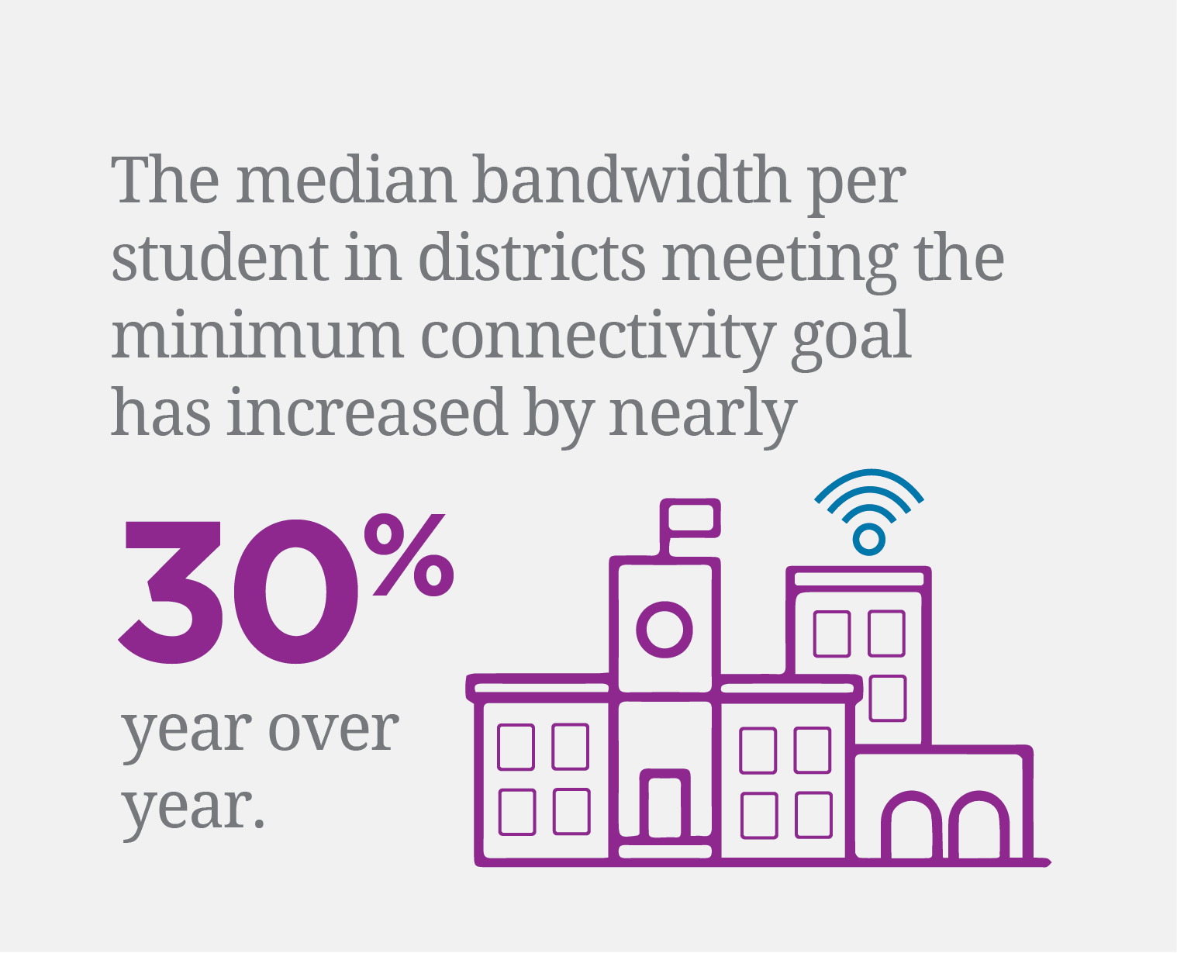
Advancing education with an experienced E-rate provider.
Your challenges and objectives
FCC internet access requirements
Affordable fiber infrastructure
Wi-Fi in every classroom
Student data privacy and security
Digital learning and content
Student devices
Online assessments
Growing bandwidth demands
Source: Education Superhighway, 2017 State of the States, 2017
Notes:
Successful learning environments leverage cutting-edge technology for applications and interactive tools. Distance-learning applications, smart boards and video all have the ability to help students excel and prepare them for the future. As an experienced and trusted E-rate provider, we use our experience designing solutions for schools, districts and libraries to help you get the most out of your network.
Colleges and universities need scalable networking solutions that are able to meet changing bandwidth needs throughout the year. From video streaming, to data transport and real-time communications, a well-connected campus is a necessity for both faculty and students. With approximately 80,000 route miles of fiber, and more than 25 years designing solutions for schools and universities, we have the network capacity to delivery scalable, high-bandwidth solutions that are secure and reliable.

Slide 47
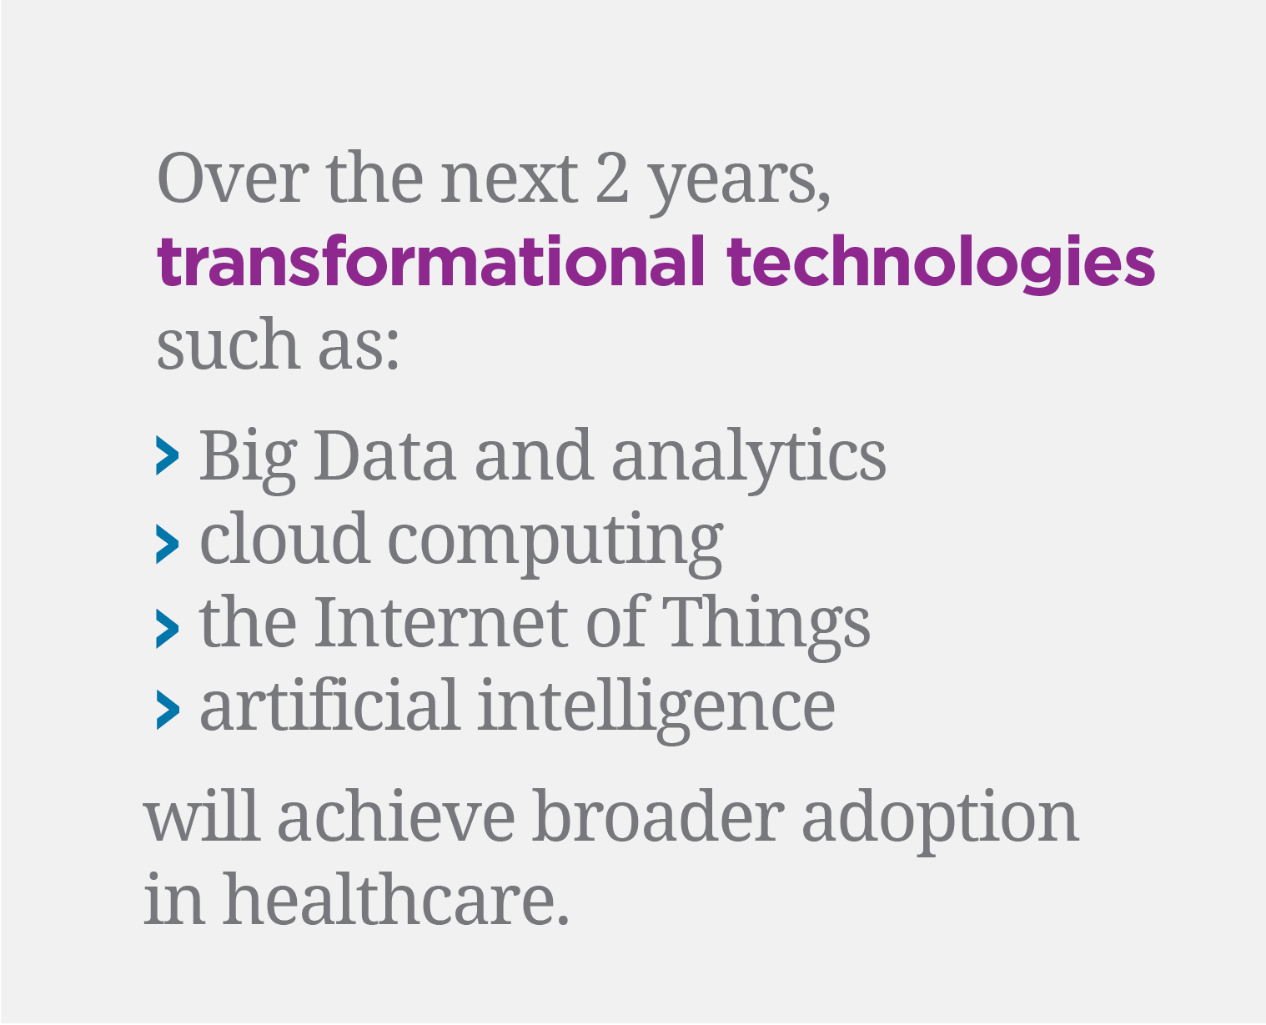
Improving patient care.
Your challenges and objectives
Delivering quality patient care
Promoting interoperability and data sharing
Cloud connectivity for on-demand IT resources
Managing healthcare information such as EHRs across providers
HIPAA privacy and security compliance
Exploding storage requirements
Source: SAP, Digital Transformation in Healthcare: A Positive Prognosis, 2017
Notes:
Successful learning environments leverage cutting-edge technology for applications and interactive tools. Distance-learning applications, smart boards and video all have the ability to help students excel and prepare them for the future. As an experienced and trusted E-rate provider, we use our experience designing solutions for schools, districts and libraries to help you get the most out of your network.
Colleges and universities need scalable networking solutions that are able to meet changing bandwidth needs throughout the year. From video streaming, to data transport and real-time communications, a well-connected campus is a necessity for both faculty and students. With approximately 80,000 route miles of fiber, and more than 25 years designing solutions for schools and universities, we have the network capacity to delivery scalable, high-bandwidth solutions that are secure and reliable.

Slide 48
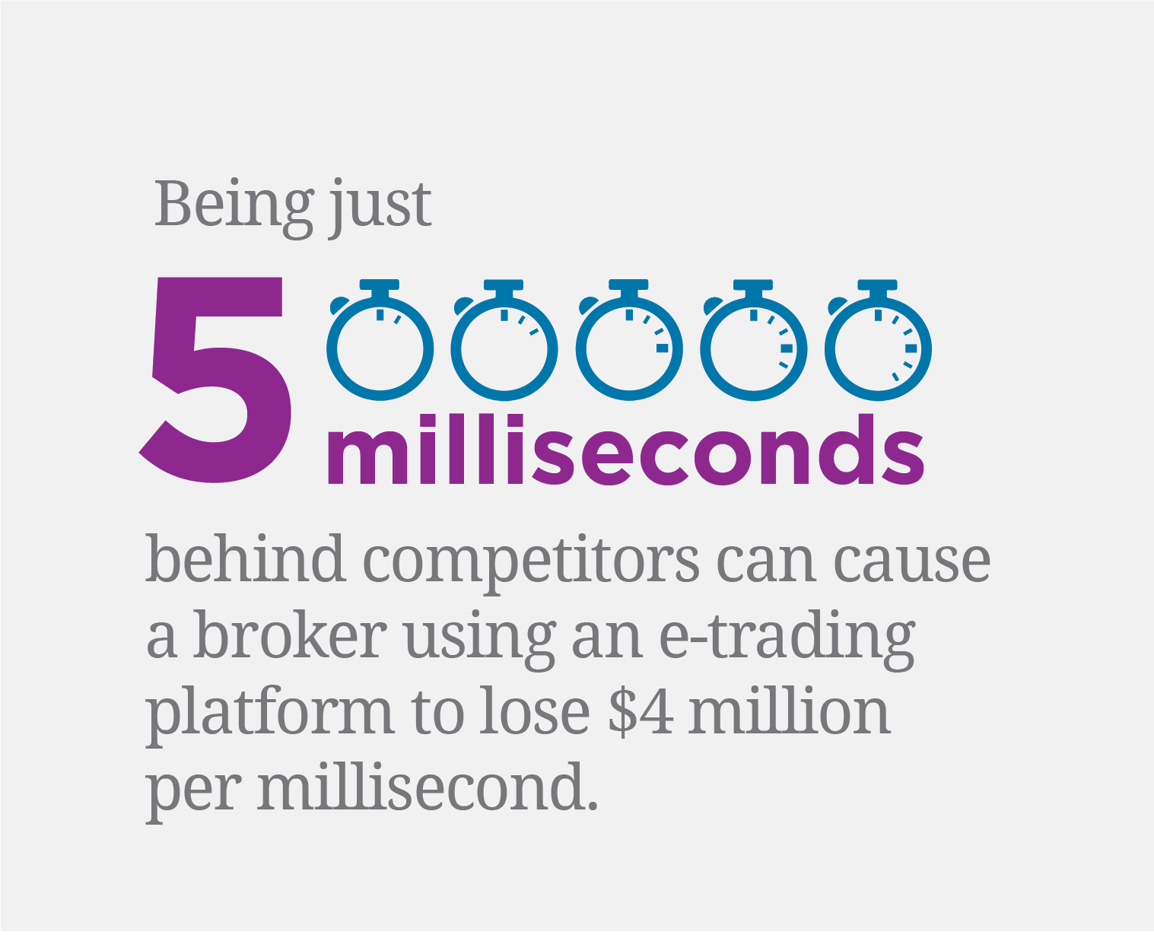
When fractions of a second matter.
Your challenges and objectives
Latency and uptime for up to the millisecond transactions
Network architecture that connects anywhere, anytime
Data privacy, cybersecurity and regulatory compliance
Cloud, SaaS, and robotics/AI implementation
Business continuity and disaster recovery
Source: WOWZA Media Systems, Ultra Low Latency Streaming: When You Have the Need for Speed, 2018
Notes:
Successful learning environments leverage cutting-edge technology for applications and interactive tools. Distance-learning applications, smart boards and video all have the ability to help students excel and prepare them for the future. As an experienced and trusted E-rate provider, we use our experience designing solutions for schools, districts and libraries to help you get the most out of your network.
Colleges and universities need scalable networking solutions that are able to meet changing bandwidth needs throughout the year. From video streaming, to data transport and real-time communications, a well-connected campus is a necessity for both faculty and students. With approximately 80,000 route miles of fiber, and more than 25 years designing solutions for schools and universities, we have the network capacity to delivery scalable, high-bandwidth solutions that are secure and reliable.

Slide 49
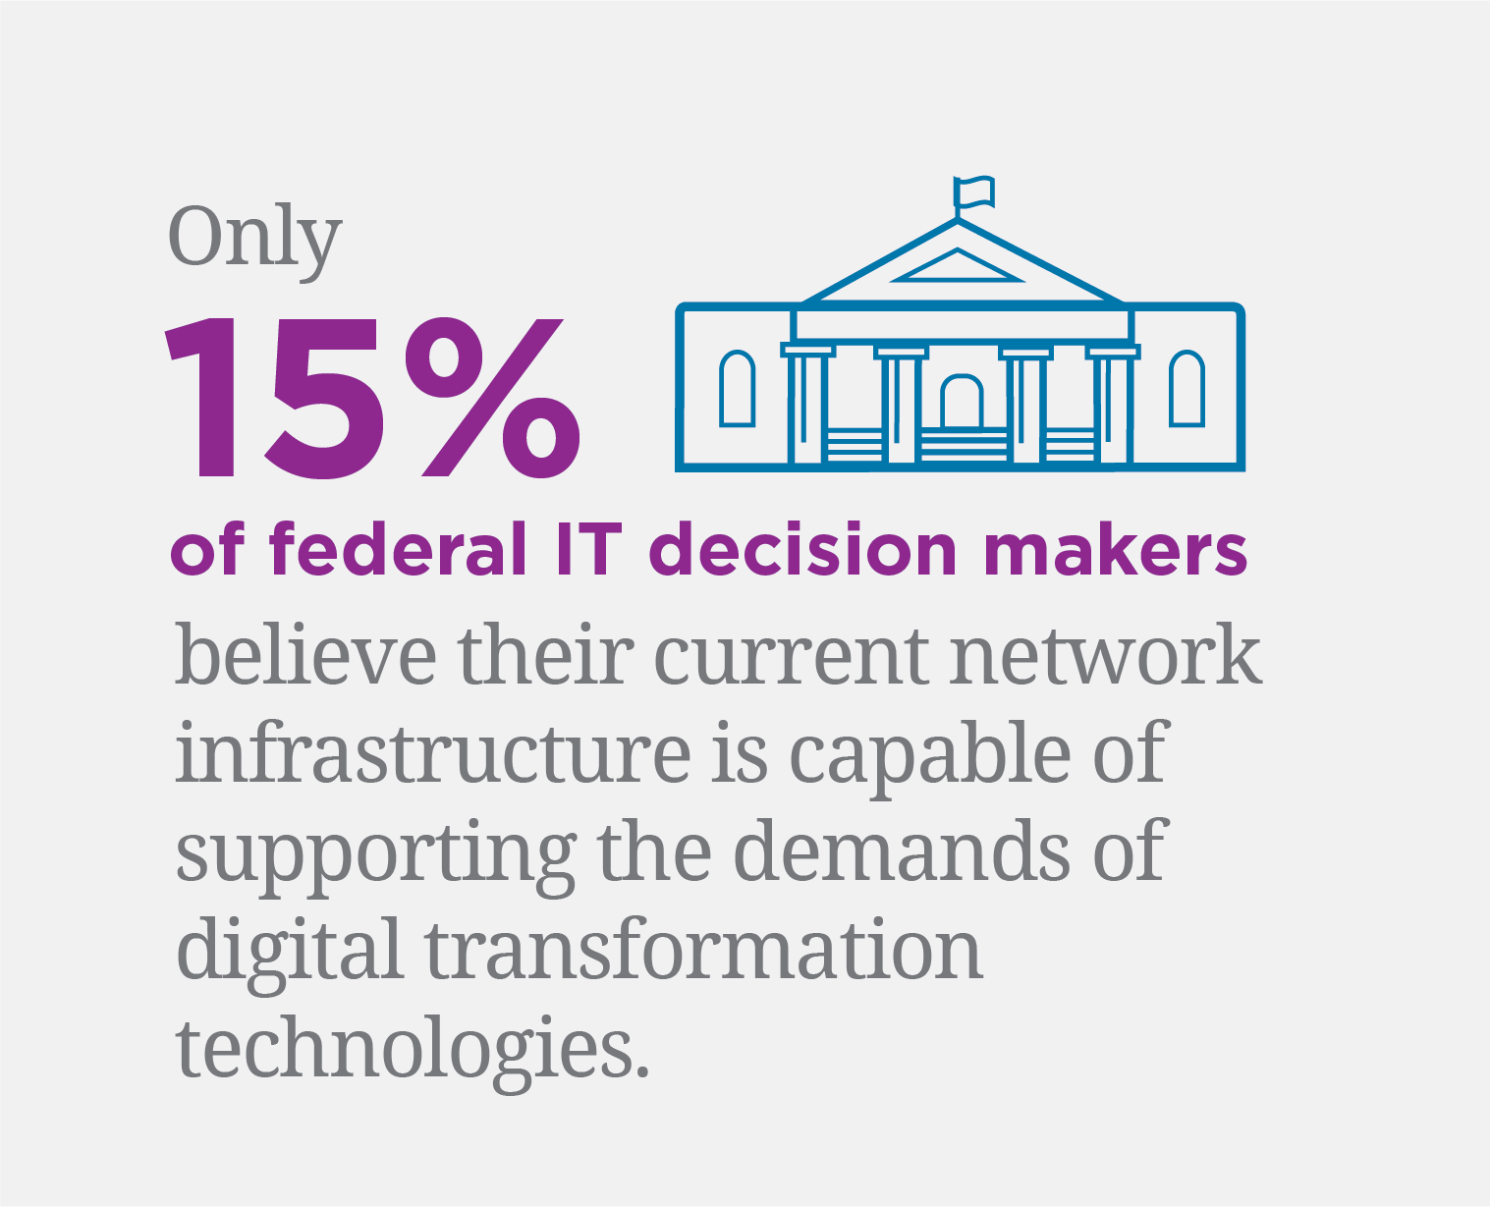
Supporting local, state, and federal agencies.
Your challenges and objectives
Easy access to information or online services for public agencies and constituents
Seamless migration and integration
Cybersecurity and disaster recovery
Cloud access, applications, and new digital technologies
Budget and cost control
Source: GCN, How SD-WAN Can Power Federal Digital Transformation, 2016
Notes:
Successful learning environments leverage cutting-edge technology for applications and interactive tools. Distance-learning applications, smart boards and video all have the ability to help students excel and prepare them for the future. As an experienced and trusted E-rate provider, we use our experience designing solutions for schools, districts and libraries to help you get the most out of your network.
Colleges and universities need scalable networking solutions that are able to meet changing bandwidth needs throughout the year. From video streaming, to data transport and real-time communications, a well-connected campus is a necessity for both faculty and students. With approximately 80,000 route miles of fiber, and more than 25 years designing solutions for schools and universities, we have the network capacity to delivery scalable, high-bandwidth solutions that are secure and reliable.

