Slide 1
The fiber network that can take you anywhere.
Customer Name
MARCH 2020

Slide 2
Our strength and stability help us deliver long-term value.
$5.8B
NYSE S&P 500
9,000+
25+
annual revenue¹
customers—a proven track record.
years owning and operating network assets.
company
1. FY2019 net revenue
Notes:
As the last owner of our assets, we’re in it for the longhaul
We’ve invested over $13B in fiber
And with a ~$81B enterprise value, we’re a stable partner in an industry with change

Slide 3
A proven partner can trust.
'94
'02
'10
'12
'14
'15
'16
'17
NewPath Networks acquired
24/7 Mid-Atlantic acquired
Sunesys acquired
Crown Castle founded
Small cell solutions business established
NextG Networks acquired
Access Fiber Group acquired
Fibernet Direct, Wilcon, Lightower acquired
Notes:
With over 25 years of expertise, we’re a proven partner
Although you may not have heard of Crown Castle, you probably know us
In the last 9 years, we’ve acquired 8 regional fiber providers—bringing the best and brightest talent to our business

Slide 4
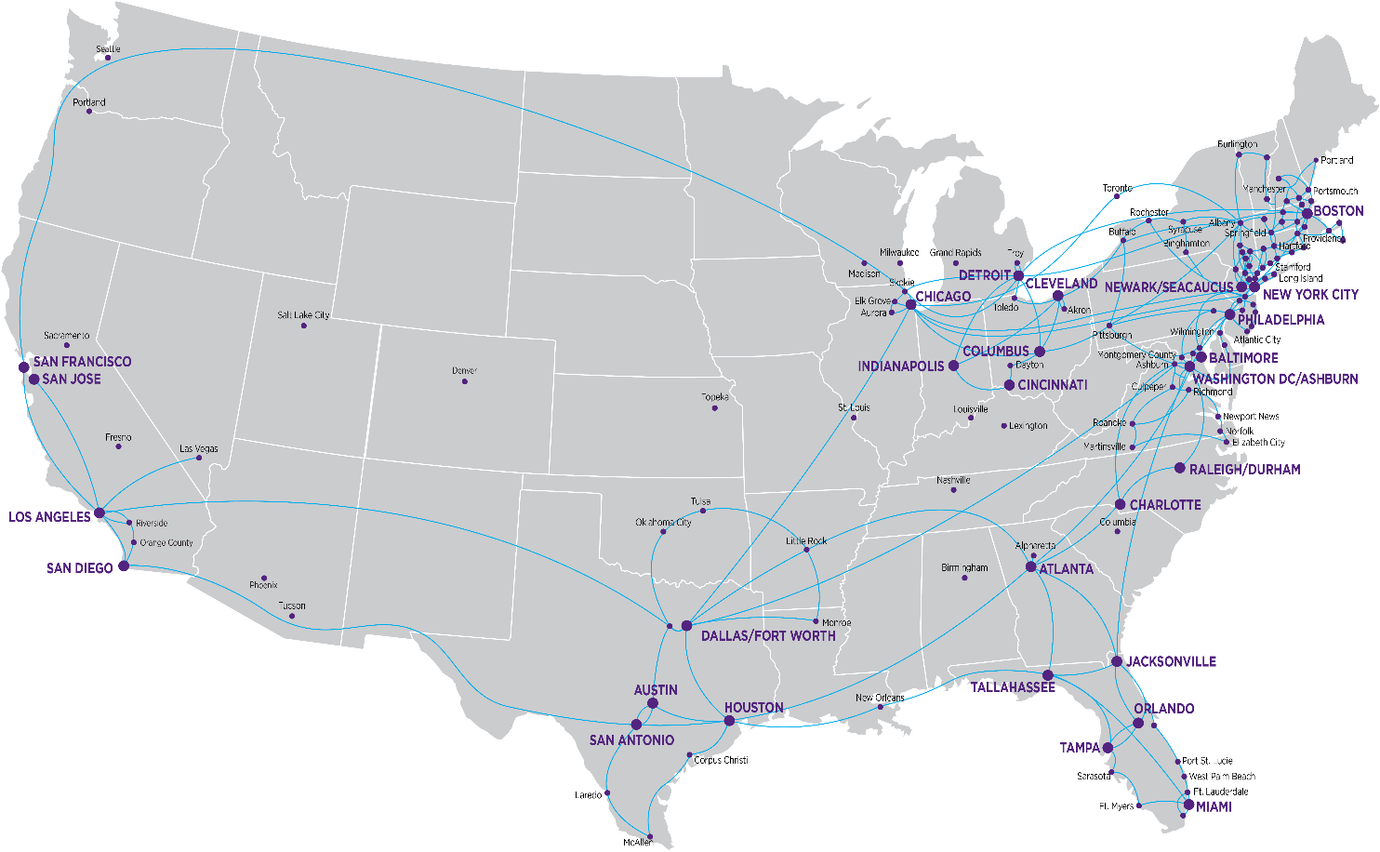
And one of largest and densest fiber networks in the country.
~80,000
route miles of fiber
32,000+ on-net buildings
900+
connected data centers, PoPs, and COs
40+ financial exchanges
>50 cloud access points
Notes:
Own and operate our network, maintaining complete control over the infrastructure

Slide 5
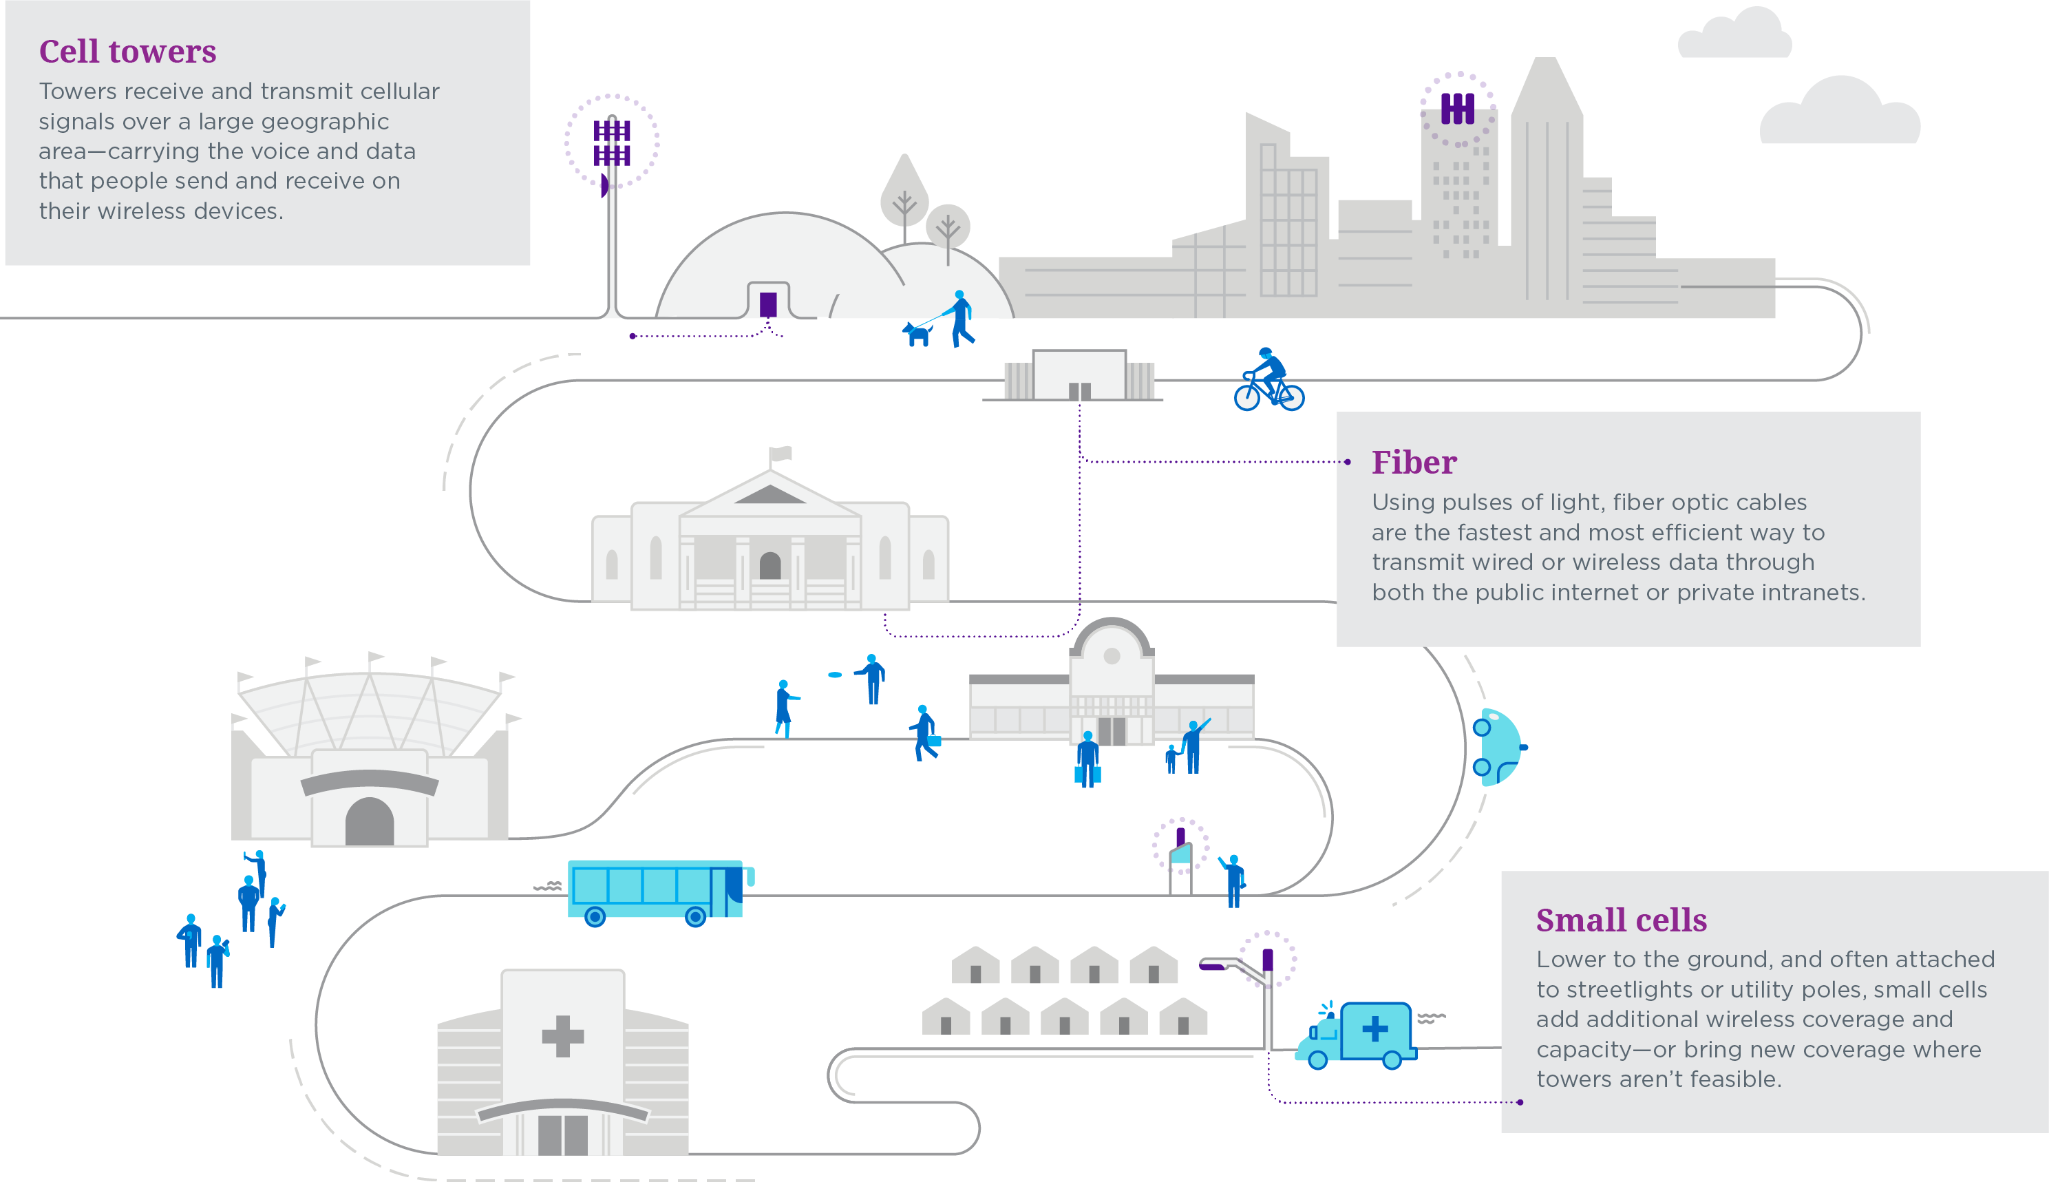
With a comprehensive portfolio of infrastructure that is unique and unmatched.
Notes:
We have a leading portfolio of shared communications infrastructure
40k+ towers, approximately 70k small cells on air or under contract, approximately 80k route miles of fiber
Towers, across every city, town and community deliver voice, text, and data to the devices people depend on
Small cells improve cover and set the stage for new advancements like IoT, smart cities, and 5G
And our nationwide network of fiber ties it together connecting businesses with mission-critical infrastructure

Slide 6
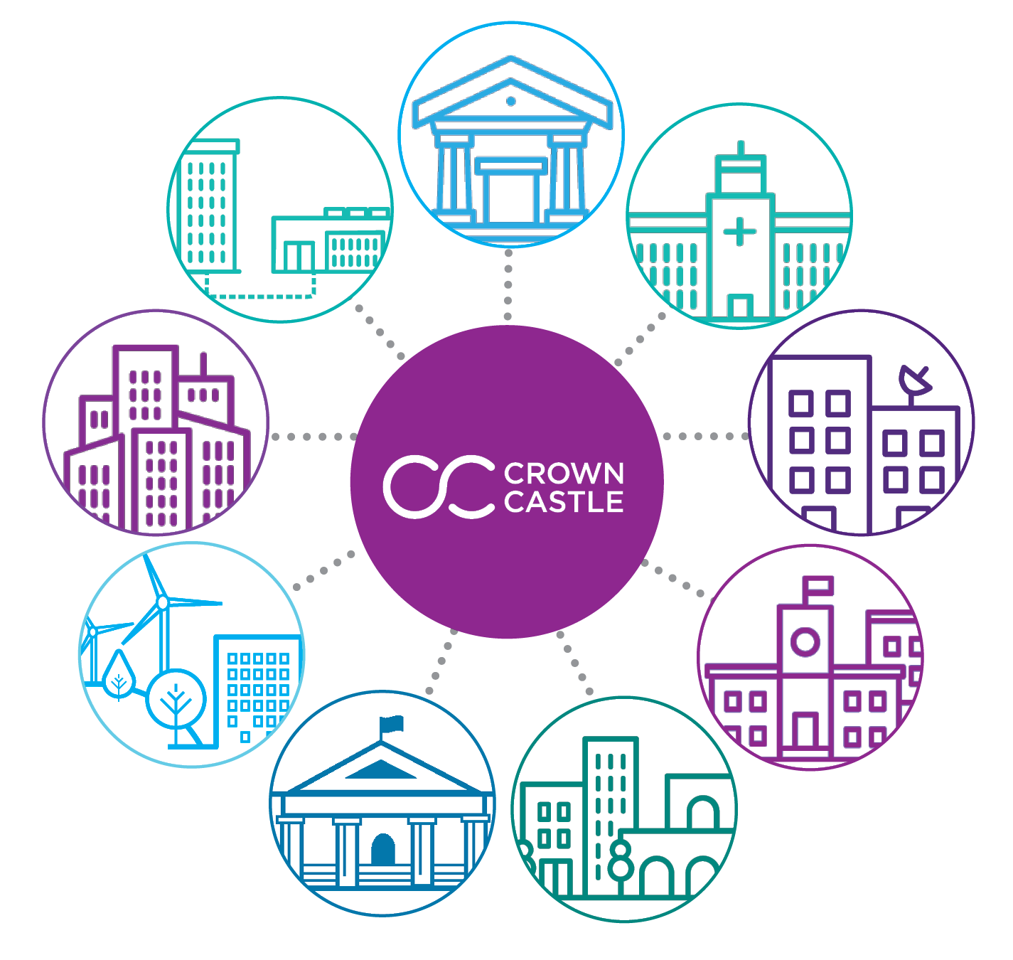
Expertise across a range of industries.
Wholesale
Professional Services
Content Distribution
Healthcare
Energy & Utilities
Media & Entertainment
Government
School Districts, Libraries & Higher Education

Slide 7
The right mix of solutions for your organization.
Dark Fiber
Unlimited bandwidth with all the control you require using your own optical resources.
Private Networks
Fully managed Ethernet or Wavelength solutions with the security, performance, and dedicated bandwidth you need.
Colocation
100+ colo facilities with high-bandwidth connectivity to our network, carrier hotels, data centers and more.
Wavelength
Fully managed, private, point-to-point solutions with dedicated bandwidth from 1Gbps to 100Gbps.
Internet Access
High-performance DIA from 50Mbps to 10Gbps+ with options for bursting and bundling with Ethernet.
Long Haul
Nationwide long haul Ethernet and Wavelength solutions.
Ethernet
Switched and dedicated Ethernet services from 10Mbps to 10Gbps with multiple configurations.
Cloud Connect
Numerous access points to AWS, Google, Azure and other key Cloud Service Providers.
Added Solutions
Optical Encryption, Distributed Denial of Service (DDoS), and Video Transport.

Slide 8
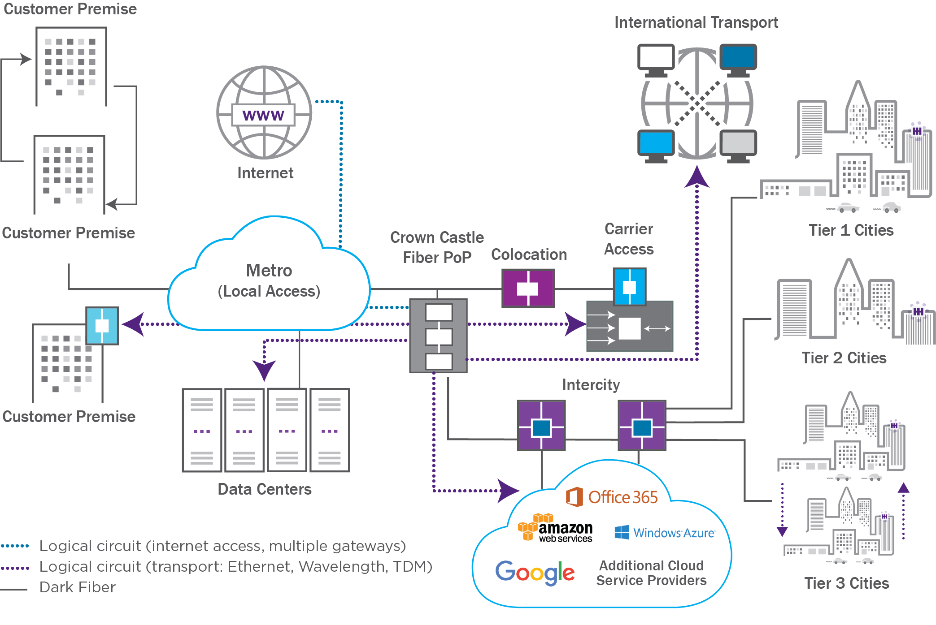
How it all works together.
Notes:
Our interconnected network provides greater flexibility and scalability
Dedicated fiber and symmetrical bandwidth
Less points of failure than LEC and other alternatives
Custom solutions with a full product suite
Flexible bandwidth offerings that scale for your needs
Traffic agnostic and carrier neutral

Slide 9
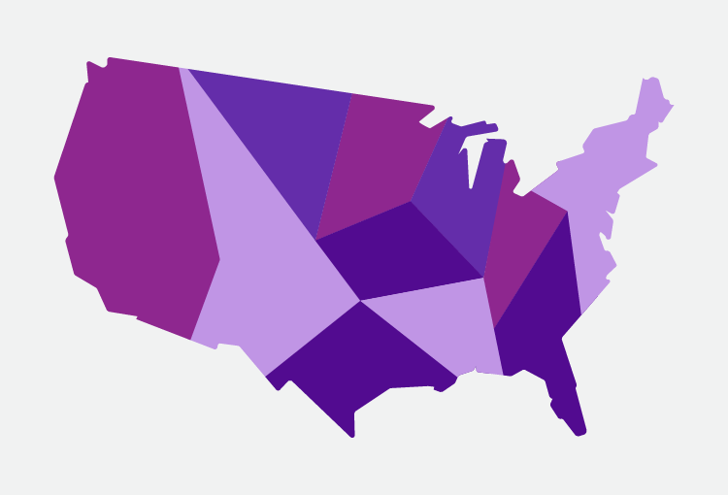
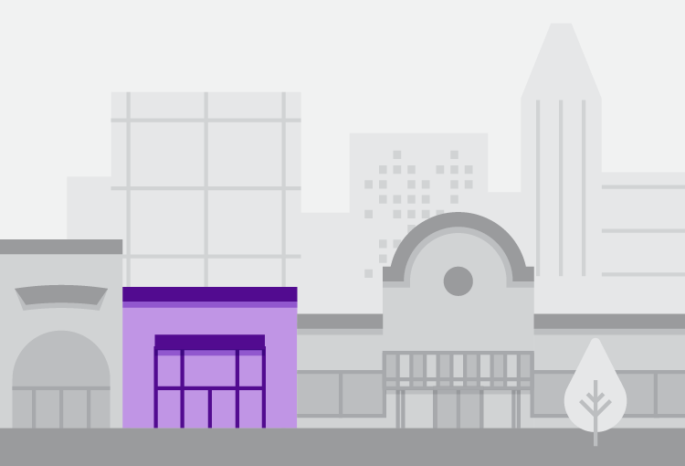
National network, backed by the strength of our local resources.
Nearly 100 offices around the country
Local service teams and 24/7 Network Operations Center support
4 geographically diverse Network Operations Centers (NOCs)
Notes:
Dedicated local team from sales to client services and project management
Local service teams around the country support a national network, 24/7/365
Escalation that includes executive resources

Slide 10
A commitment to service and support.
We mobilize response teams around-the-clock.
Network Operations Center (NOC)
Full-time employees -- never outsourced
Direct access to a technician
Generator and UPS protected facilities
Geographically diverse NOC locations
Emergency response teams skilled in disaster preparedness and response
Strategic positioning of resources before disaster strikes
24/7/365
active network surveillance to ensure systems remain up and running
99.999
we strive for the highest level of network uptime
90%
of issues are resolved within the NOC and require no further escalation
2x
per year, we conduct weather and disaster simulation tests
Notes:
Direct access to network operations including full time fault management and trouble reporting
Strategic planning of resources before a disaster strikes and an emergency response team skilled in disaster preparedness
Because we own our network, we’re directly invested in the integrity and can provide faster response times and issue resolution

Slide 11
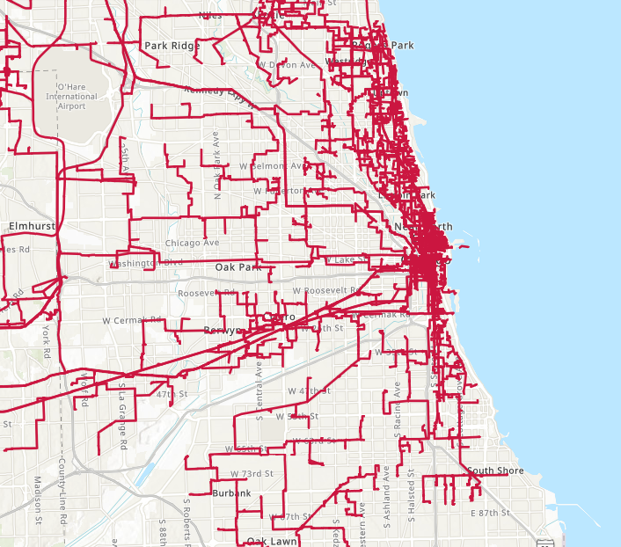
Your local footprint: Chicago.

Slide 12
Why Crown Castle Fiber?
LARGEST NETWORK
UNPARALLELED
RELIABILITY
CUSTOMER-CENTRIC SOLUTIONS
DEMONSTRATED
INNOVATION
> Own, operate, and lease ~80k route miles of fiber
> 32k+ on-net locations
> 900+ connected data centers, PoPs, COs
> More diverse paths and unique routes
> Nearly 100 offices nationwide
> Offer 99.999% availability, striving for the highest level of network uptime
> Emergency response team (aCERT)
> 24/7 NOC support
> Strong SLAs
> Dedicated account team for every customer
> Customer-first culture drives every aspect of our business
> Custom designed solutions built with quality
> Full transparency in fiber routes
> Comprehensive suite of networking solutions
> Setting the stage for next-gen networks and smart communities
> Scalability to meet the needs of business applications—today and tomorrow
> Future-proof technologies for complex solutions
Notes:
A strategic partner committed to your long-term business goals
Nimble, customer focused company
Deliver connectivity securely, reliably, and diversely with ability to scale without constraints

Slide 13
Your dedicated team of fiber experts.
Sales
Sales Engineering
Client Services
Account Executive Name Title Here (123) 456-7890 First.Lastname@crowncastle.com
Sales Engineer Name Title Here (123) 456-7890 First.Lastname@crowncastle.com
Client Services Manager Name Client Services Manager (123) 456-7890 First.Lastname@crowncastle.com
Network Operations
Service Management
24/7/365 NOC 855-93-FIBER, Option # FiberSupport@crowncastle.com
Project Manager Name Project Manager Title (123) 456-7890 First.Lastname@crowncastle.com
Notes:
Please verify due to organization shifts.

Slide 14
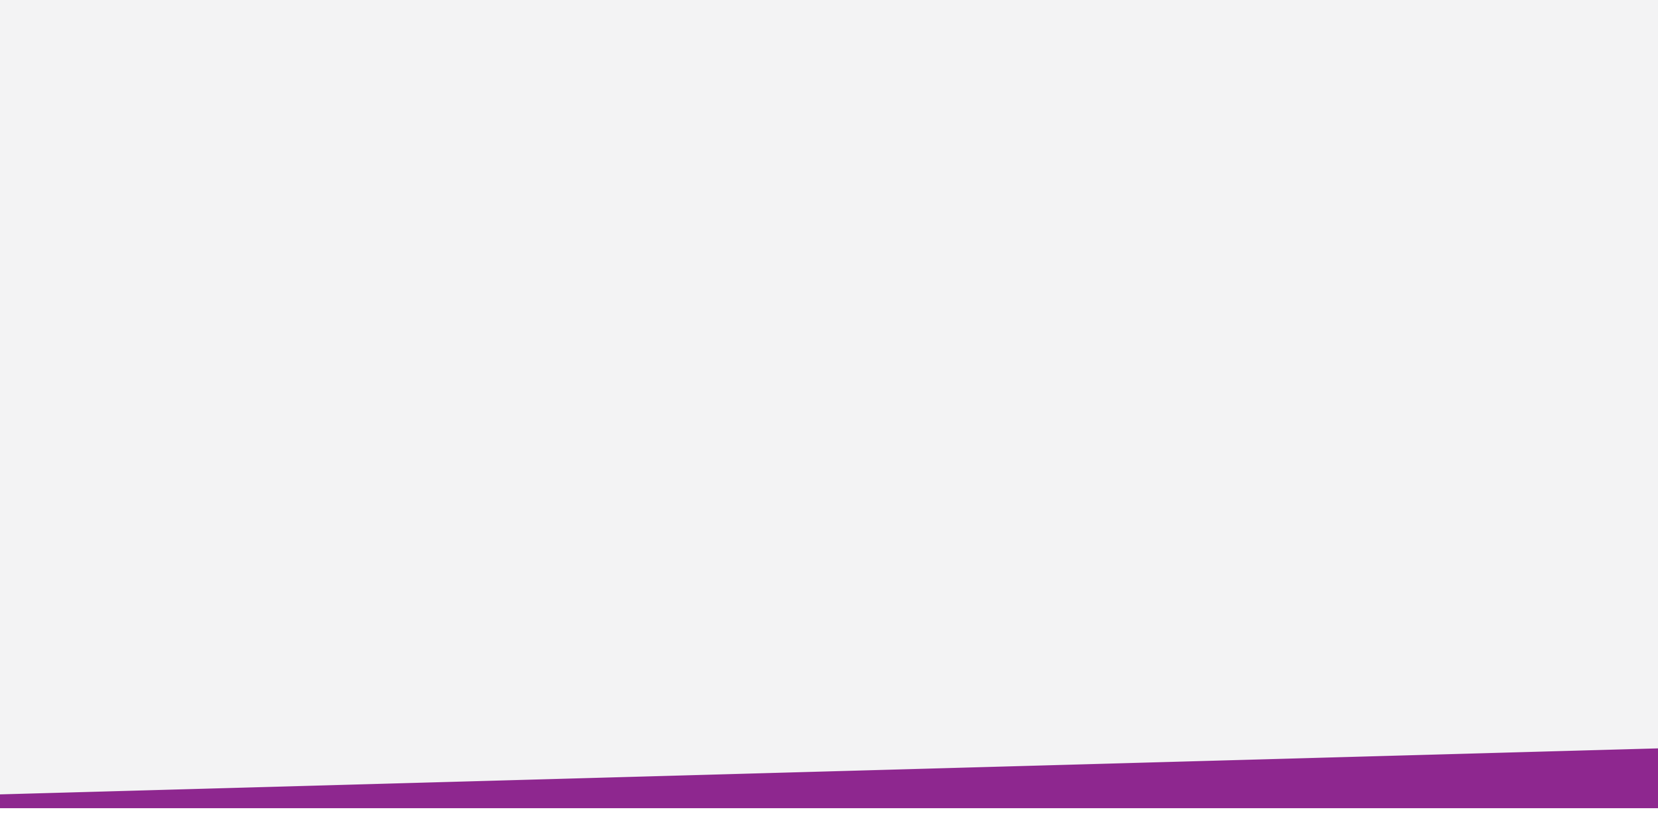
Thank you.
For further information please contact:
First Name Last Name
(XXX) XXX-XXXX
name@crowncastle.com
Fiber.CrownCastle.com

Slide 15
Ask our competition.
LARGEST NETWORK
UNPARALLELED
RELIABILITY
CUSTOMER-CENTRIC SOLUTIONS
DEMONSTRATED
INNOVATION
> Do you have unique and diverse routes and points-of-entry?
> Do you own your network?
> Do you have direct access to the NOC, rather than routing through a queue?
> What is your protocol for rapid, proactive support in an emergency?
> Do you offer custom solutions?
> Do you use a consultative approach to identifying specific needs for my network?
> Are you flexible in your contract terms?
> Are your solutions scalable for my business needs?
> Are your solutions cost-efficient (no forklift upgrade for more bandwidth)?
Notes:
A strategic partner committed to your long-term business goals
Nimble, customer focused company
Deliver connectivity securely, reliably, and diversely with ability to scale without constraints

Slide 16
Proposed solution.
Solution | Location | Term | NRC | MRC
 |  |  | $ | $
Total Charges |  |  | $ | $
Notes:
Insert the proposal you’ve worked up for the customer. If you are presenting multiple options, please do a slide per option.

