Slide 1
Crown Castle Fiber
A Stable Partner you can trust
The right solution for your organization—today and tomorrow.
Rep Name
Rep Title
Phone: XXX-XXX-XXXX
Email: First.Last@CrownCastle.com

Slide 2
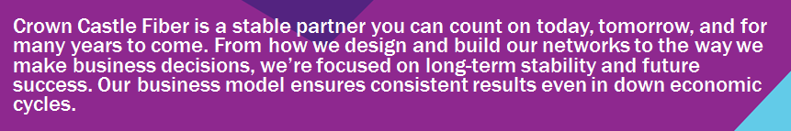
Our strength and stability help us deliver long-term value.
$5B+
NYSE S&P 500
20+
YEARS
LAST OWNER
annual revenue
company
of owning and operating network assets
of our network assets
PROPRIETARY & CONFIDENTIAL

Slide 3
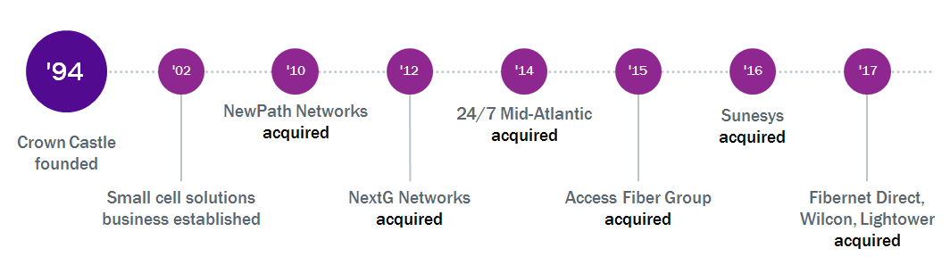
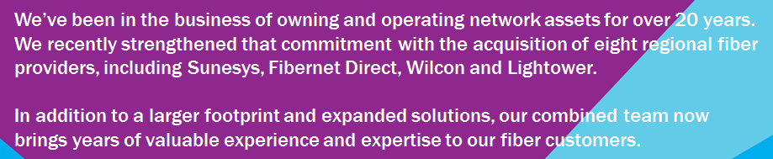
We’ve spent over 20 years growing our network and strengthening our expertise.
'94
'12
'17
PROPRIETARY & CONFIDENTIAL

Slide 4
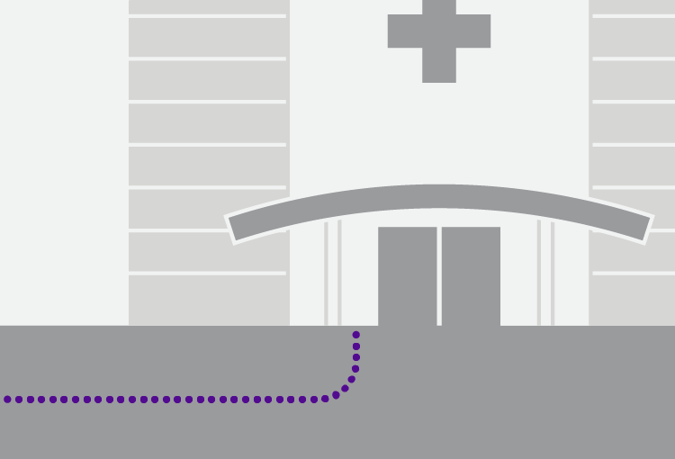
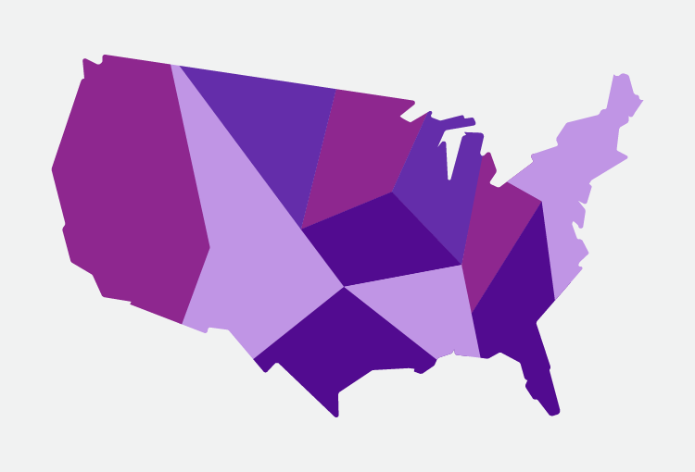


A national network backed by the strength of our local resources.
60,000 route miles of fiber
50+ offices
around the country
Local service teams available 24/7
PROPRIETARY & CONFIDENTIAL

Slide 5
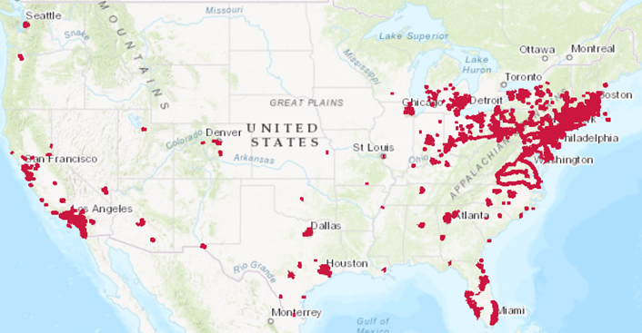
A comprehensive portfolio of infrastructure that is unique and unmatched.
40,000+
towers
50,000+
small cells on air or under contract
60,000+
route miles of fiber
25,000+
on-net buildings
900+
connected data centers
PROPRIETARY & CONFIDENTIAL

Slide 6
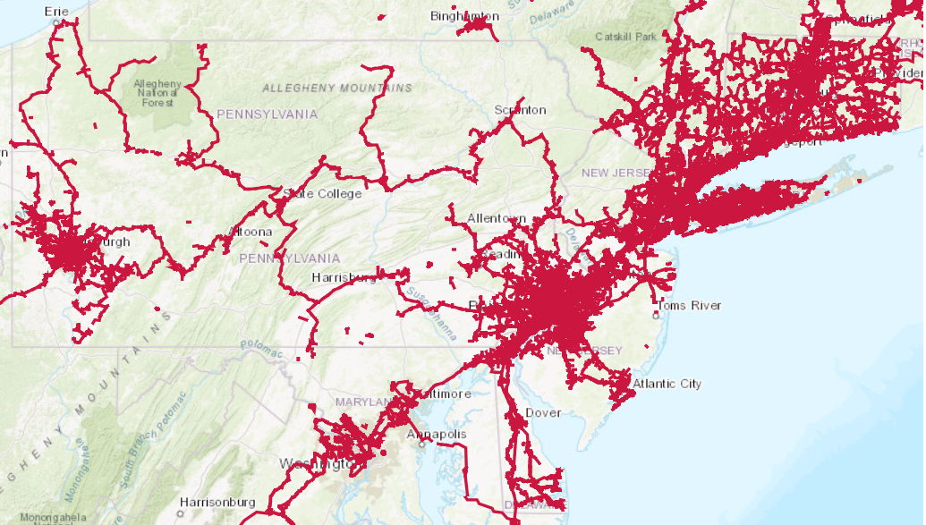
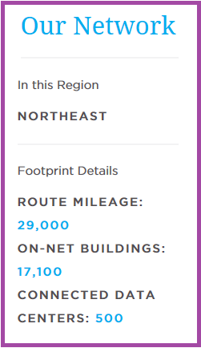
Northeast Regional Footprint
PROPRIETARY & CONFIDENTIAL

Slide 7
Market specific map.
Insert regional map slide and/or slides from below (slides 19-31) here
PROPRIETARY & CONFIDENTIAL

Slide 8

Crown Castle Fiber Four Pillars of Success.
As your strategic network partner Lightower is committed to your long-term business goals and provides scalable connectivity that grows with your business - so whatever the future brings, you’ll be ready.
CONNECTIVITY
PERFORMANCE
FUTURE-PROOF
SUPPORT
60,000+ fiber route miles
25,000+ service locations
Connected to 900+ major data centers, 500+ telco hotels & CO’s, 40+ financial exchanges
Unique & diverse network assets including routes & points-of-entry
Custom designed solutions for each customer to their exact specifications, including routing & POE
We own & operate our own all-fiber network
We maintain 99.999% availability across the Lightower Network, keeping customers connected where others fail
Comprehensive suite of networking solutions with strong SLA’s
Geographically diverse NOC locations
Over 25 years of experience designing & delivering all-fiber solutions
Local market expertise for complex solutions
We provide flexible solutions that are easily scaled no matter where your business takes you
Best-of-breed technologies to offer you the right solutions when you need them
Proven industry-specific solutions to meet needs of business applications today and tomorrow
Ownership of network allows for best possible solution design, support, & service
Customer-first culture throughout the organization
Atlantic-ACM award winner ranking first in network performance and customer service
Consultative approach to every solution
Dedicated Lightower Account Team for every customer
World-class customer support & service, including the Lightower Emergency Response Team (aLERT)

Slide 9
We design the network solution that’s right for your specific needs.
Ethernet
Dark Fiber
Wavelengths
Ethernet Private Line (EPL)
Ethernet Virtual Private Line (EVPL)
Ethernet LAN (ELAN)
Metro-E Advanced Private Line
10 Mbps to 100 Gbps
Custom designed dark fiber networks
throughout footprint
Complete control over bandwidth,
services, and latency management
1 GigE, 10 GigE, 40 GigE, 100 GigE, OC(x), OTU 1-4 Fiber Channel
Layer 1 security, supports Layer 2 & 3 services
Internet Access
Cloud Connectivity
Private Networks
50 Mbps to 10 Gbps
At the port, dedicated or burstable
High availability & sharing options
Direct fiber connections to key cloud Service Providers
Amazon Web Services
Azure and Office 365
Ethernet and wavelength service
Fully managed, custom designed networks with private, dedicated resources
Proactively monitored 24/7 by Lightower
Colocation
Video Transport
Long Haul
Over 100 Crown Castle Fiber colocation facilities including Boston, Chicago, Columbus, Hartford, Providence, Marlborough, NYC, Newark, Philadelphia, Springfield, Worcester, Los Angeles, Miami
Industry-leading video transport supporting a range of formats including SMPTE ASI, SD-SDI, HD-SDI, 3G-SDI
Nationwide long haul Ethernet and Wavelength services
PROPRIETARY & CONFIDENTIAL

Slide 10
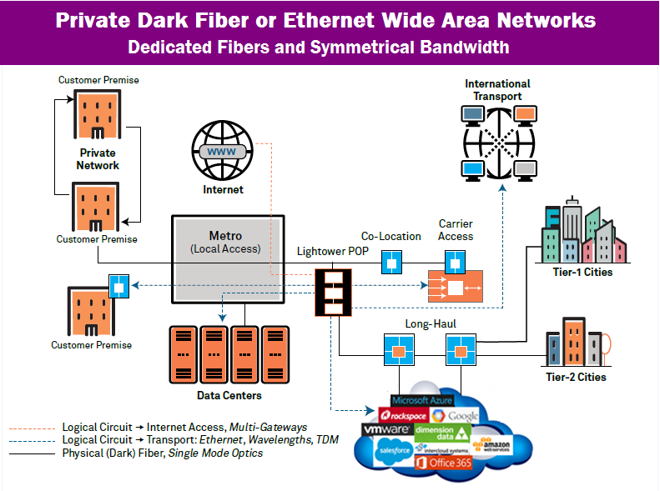


The Crown Castle Fiber Advantage.
  Connectivity
    Private line, Ethernet, Dedicated Internet delivered on end-to-end fiber optics
      High availability, high bandwidth
      Less points of failure vs. incumbent or other alternatives
      Greater flexibility – Ethernet and TDM services
      Connection to alternative network for greater diversity
      Scalability
    Ease & speed of bandwidth upgrades unparalleled
    Incremental bandwidth pricing extremely attractive
    Unique ability to meet seasonality or project-related needs with flexible bandwidth offerings
  Flexibility
    Utilizing contractual & financial models to meet customers needs
    Stream-lined organizational structure leads to efficiency
    Service & carrier neutral- TDM, Ethernet & Dark Fiber

Slide 11
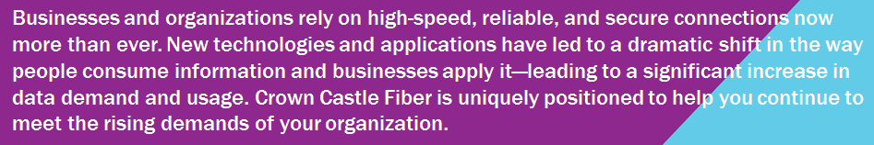
Demand for high-speed, secure bandwidth continues to grow.
155%
increase in enterprise WAN traffic in 2016.¹
$100K+
average hourly cost of network downtime for over 98% of enterprise businesses.³
25x
more media and entertainment cloud storage by 2021.⁵
77%
of US consumers are interested in seeing a healthcare provider virtually.²
99%
of classrooms will have broadband and wi-fi by 2021.⁴
Aryaka, 2017 State of the WAN, 2017.
Advisory Board, Virtual Visits Consumer Choice Survey, June 2017.
Information Technology Intelligence Consulting (ITIC), Technology Trends and Deployment Survey, 2017.
Cisco, COSN 2016: A Recap, April 2016.
Coughlin Associates, Digital Storage for Media and Entertainment Report, 2017.
PROPRIETARY & CONFIDENTIAL

Slide 12
With experience across a range of industries, we know what it takes to help you get ahead.
Financial & Professional Services
Government
Healthcare
Energy & Utilities
Media & Entertainment
Content Distribution
School Districts & Libraries
Wholesale
Higher Education
PROPRIETARY & CONFIDENTIAL

Slide 13

Select customers.
PROPRIETARY & CONFIDENTIAL

Slide 14

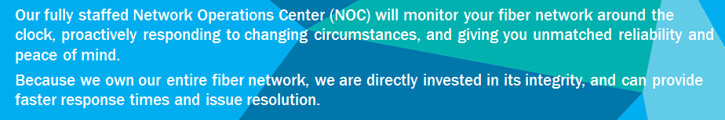
We’re dedicated to helping you succeed.
Multiple NOCs
geographically diverse, and always available to you with direct access.
A commitment to service and support:
  Best-in-class service-level agreement
  Network Operation Centers
    24/7 proactive monitoring
    Reporting and analysis
Monitoring
full-time fault management and trouble reporting
Planning
Strategic positioning of resources before disaster strikes
aLERT
Emergency response team skilled in disaster preparedness and response
PROPRIETARY & CONFIDENTIAL

Slide 15

In today’s competitive climate, you need more than a service provider. You need a partner.
customer first culture
customized solutions
24/7 network monitoring
award winning customer support
PROPRIETARY & CONFIDENTIAL

Slide 16

The right partner for your business—today and into the future.
Consultative
Expertise
Service
Stability
We take the time
to understand your specific needs, so we can customize the best solutions for your business—today and tomorrow.
We bring over 20 years of experience working with more than 3,000 customers across a range
of industries.
Whatever your needs, our dedicated local service teams are always there to help—any day, any time.
As an S&P 500 company, you can count on
us to deliver long-term value.
PROPRIETARY & CONFIDENTIAL

Slide 17
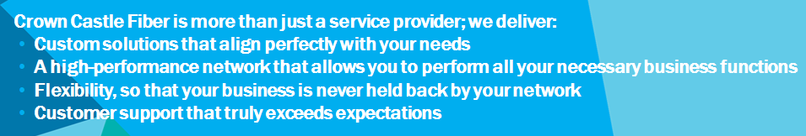
Choosing a network partner; key questions.
Connectivity
Performance
Future Proof
Support
Can they provide custom solutions?
Are their routes and points-of-entry unique and diverse?
Do they own their own network?
Do they provide direct access to the NOC, rather than routing you through
a queue?
Can they provide scalable solutions
that change with your business needs?
Can they be flexible and cost-effective
in their contract terms?
Do they provide consultation to
identify your specific needs?
What is their protocol for rapid, proactive support in an emergency?
PROPRIETARY & CONFIDENTIAL

Slide 18
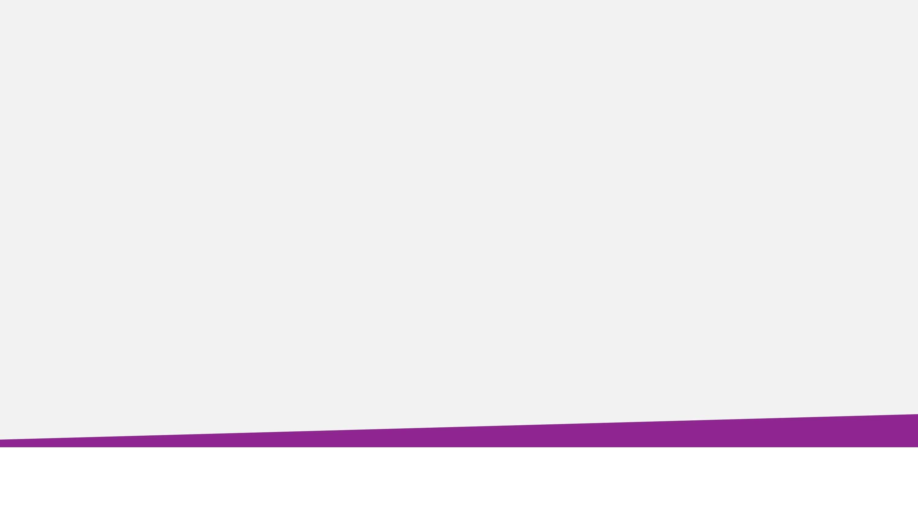
Crown Castle Fiber is a nimble, customer focused company with the benefit of a private Fiber optic network that delivers connectivity - securely, reliably, diversely and with the ability to scale without constraints.
For further information please contact:
Rep Name
Rep Title
Phone: XXX-XXX-XXXX
Email: First.Last@CrownCastle.com
Fiber.CrownCastle.com
PROPRIETARY & CONFIDENTIAL

Slide 19
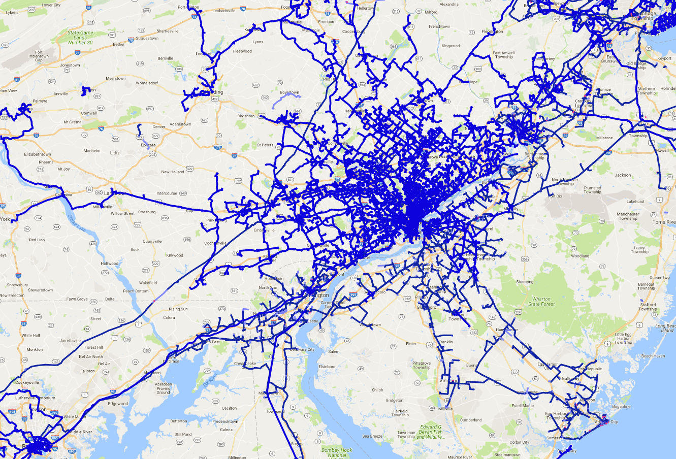
Philadelphia/South & Central NJ Network
Crown Castle Fiber is the premier provider of all-fiber, high-performance networking solutions delivered over our own network, enabling award-winning customer support and service reliability.
PROPRIETARY & CONFIDENTIAL

Slide 20
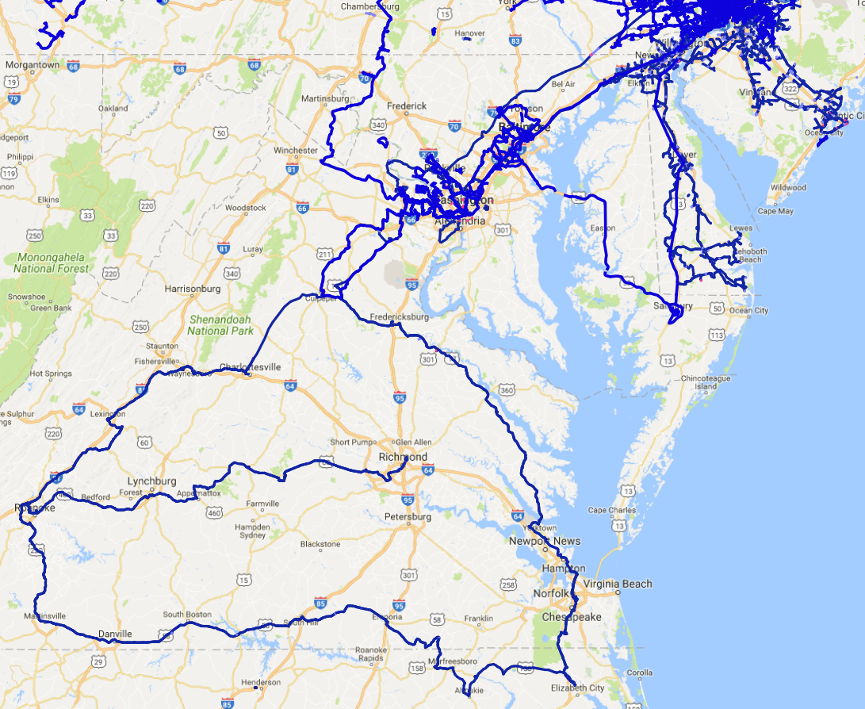
Delaware, Baltimore, Washington, Virginia Network
Crown Castle Fiber is the premier provider of all-fiber, high-performance networking solutions delivered over our own network, enabling award-winning customer support and service reliability.
PROPRIETARY & CONFIDENTIAL

Slide 21
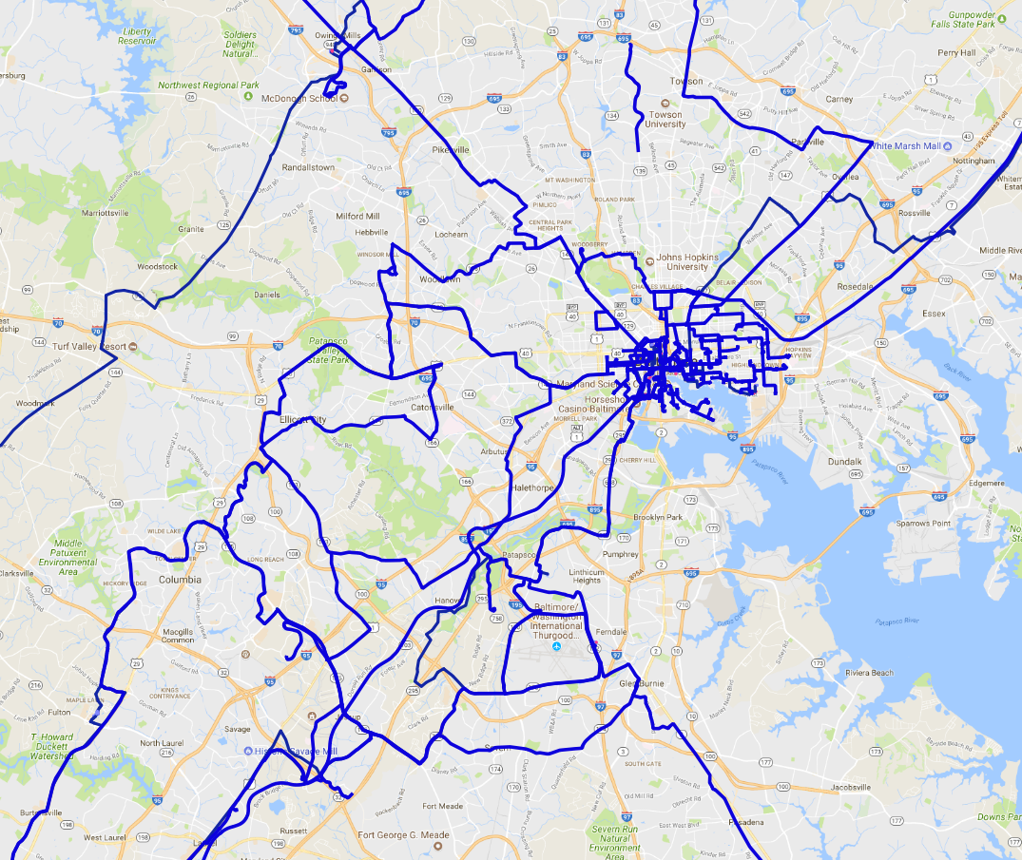
Baltimore Network
Crown Castle Fiber is the premier provider of all-fiber, high-performance networking solutions delivered over our own network, enabling award-winning customer support and service reliability.
PROPRIETARY & CONFIDENTIAL

Slide 22
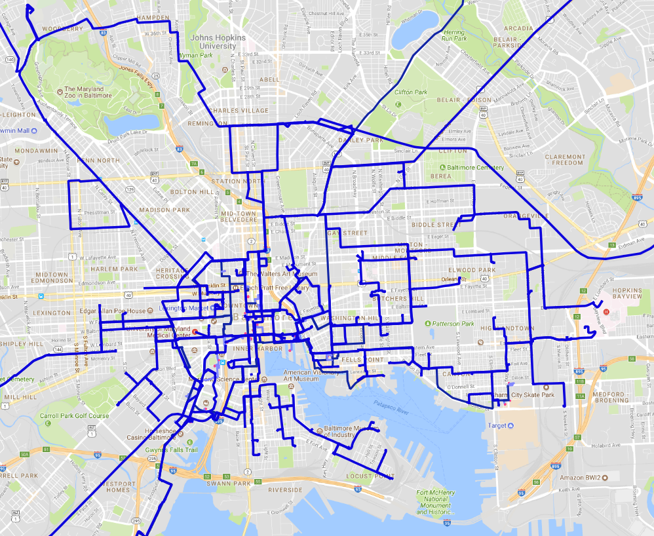
Baltimore Network
Crown Castle Fiber is the premier provider of all-fiber, high-performance networking solutions delivered over our own network, enabling award-winning customer support and service reliability.
PROPRIETARY & CONFIDENTIAL

Slide 23
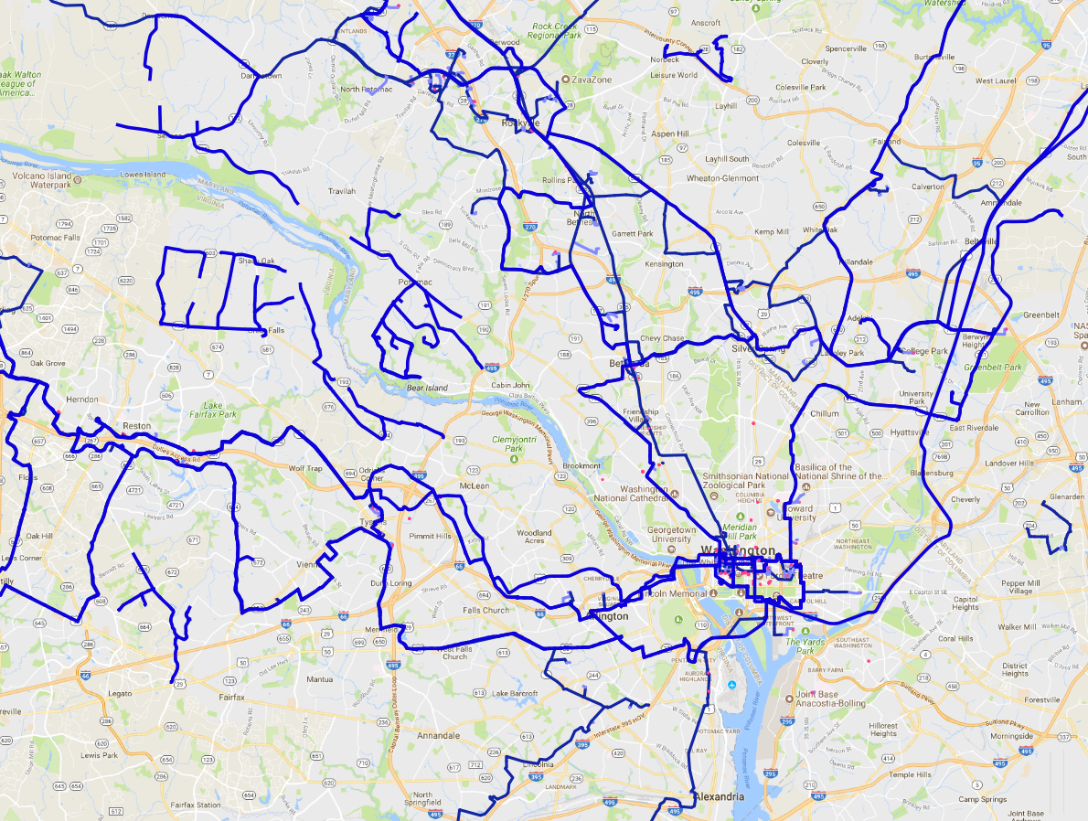
Washington, DC Network
Crown Castle Fiber is the premier provider of all-fiber, high-performance networking solutions delivered over our own network, enabling award-winning customer support and service reliability.
PROPRIETARY & CONFIDENTIAL

Slide 24
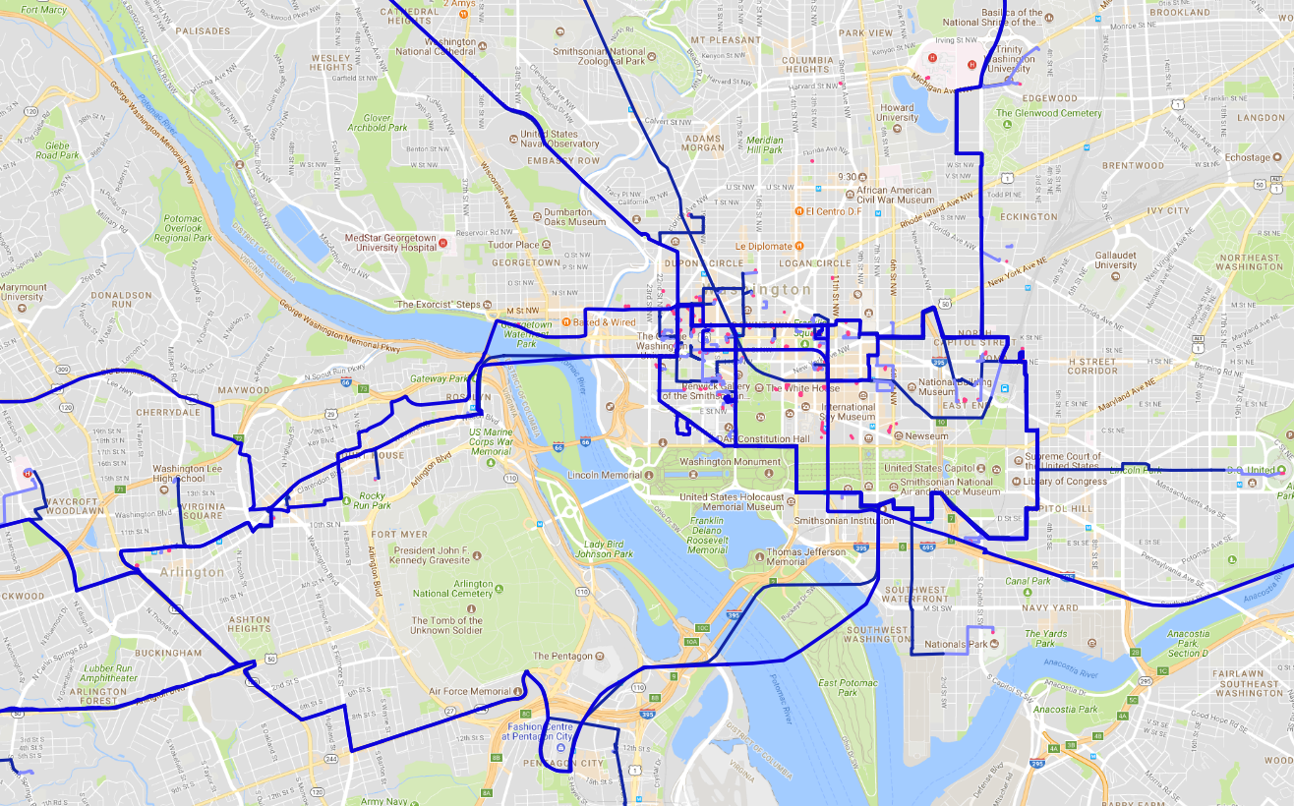
Washington, DC Network
Crown Castle Fiber is the premier provider of all-fiber, high-performance networking solutions delivered over our own network, enabling award-winning customer support and service reliability.
PROPRIETARY & CONFIDENTIAL

Slide 25
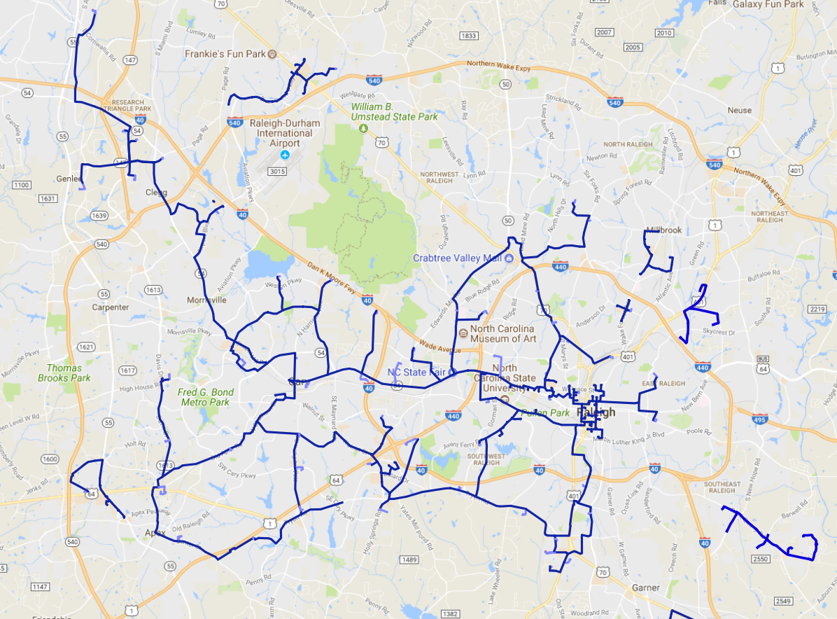
Raleigh, NC Network
Crown Castle Fiber is the premier provider of all-fiber, high-performance networking solutions delivered over our own network, enabling award-winning customer support and service reliability.
PROPRIETARY & CONFIDENTIAL

Slide 26
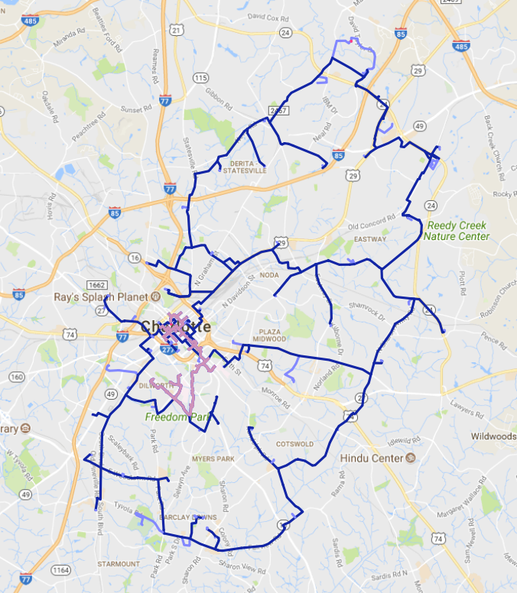
Charlotte, NC Network
Crown Castle Fiber is the premier provider of all-fiber, high-performance networking solutions delivered over our own network, enabling award-winning customer support and service reliability.
PROPRIETARY & CONFIDENTIAL

Slide 27
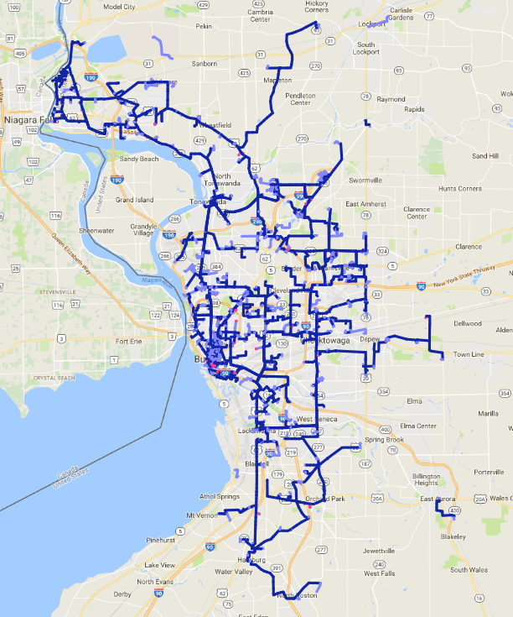
Buffalo, NY Network
Crown Castle Fiber is the premier provider of all-fiber, high-performance networking solutions delivered over our own network, enabling award-winning customer support and service reliability.
PROPRIETARY & CONFIDENTIAL

Slide 28
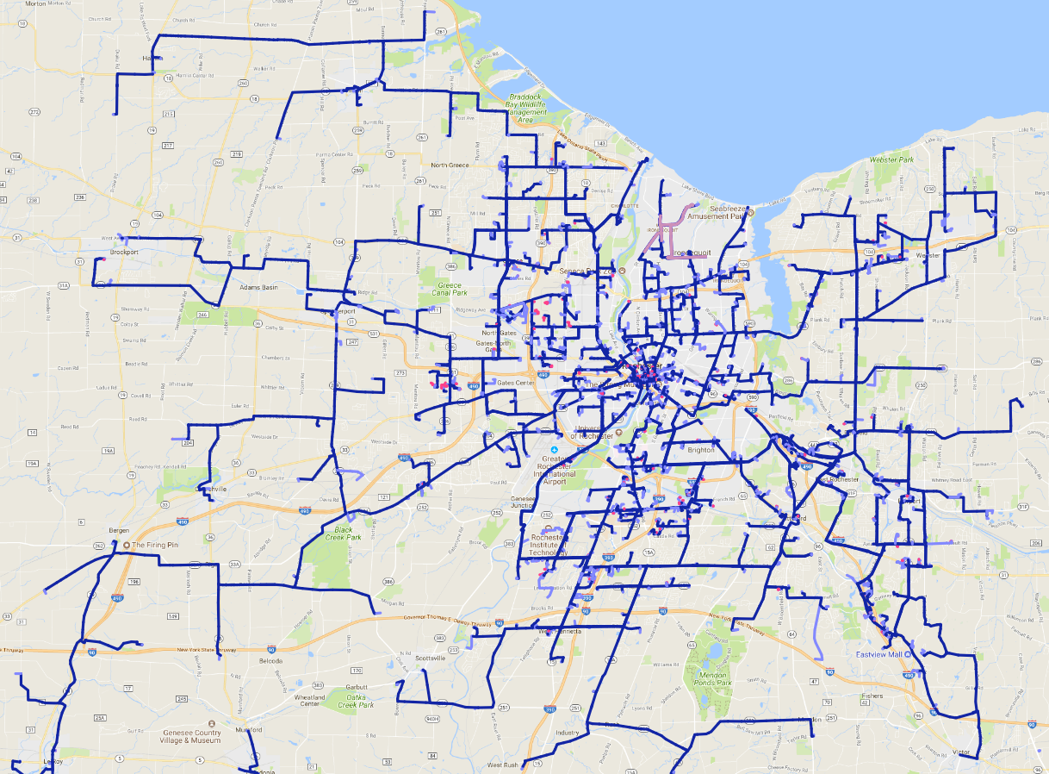
Rochester, NY Network
Crown Castle Fiber is the premier provider of all-fiber, high-performance networking solutions delivered over our own network, enabling award-winning customer support and service reliability.
PROPRIETARY & CONFIDENTIAL

Slide 29
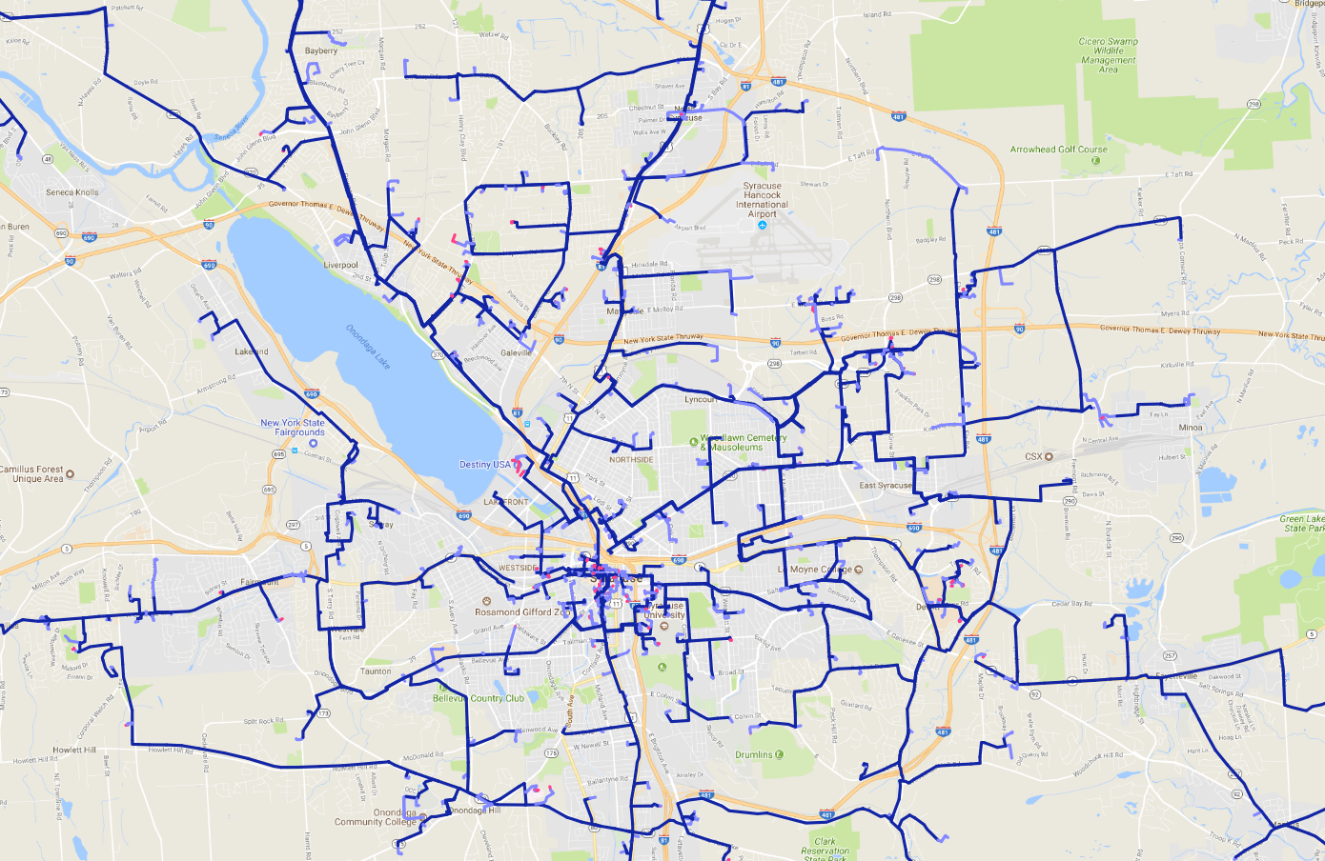
Syracuse, NY Network
Crown Castle Fiber is the premier provider of all-fiber, high-performance networking solutions delivered over our own network, enabling award-winning customer support and service reliability.
PROPRIETARY & CONFIDENTIAL

Slide 30
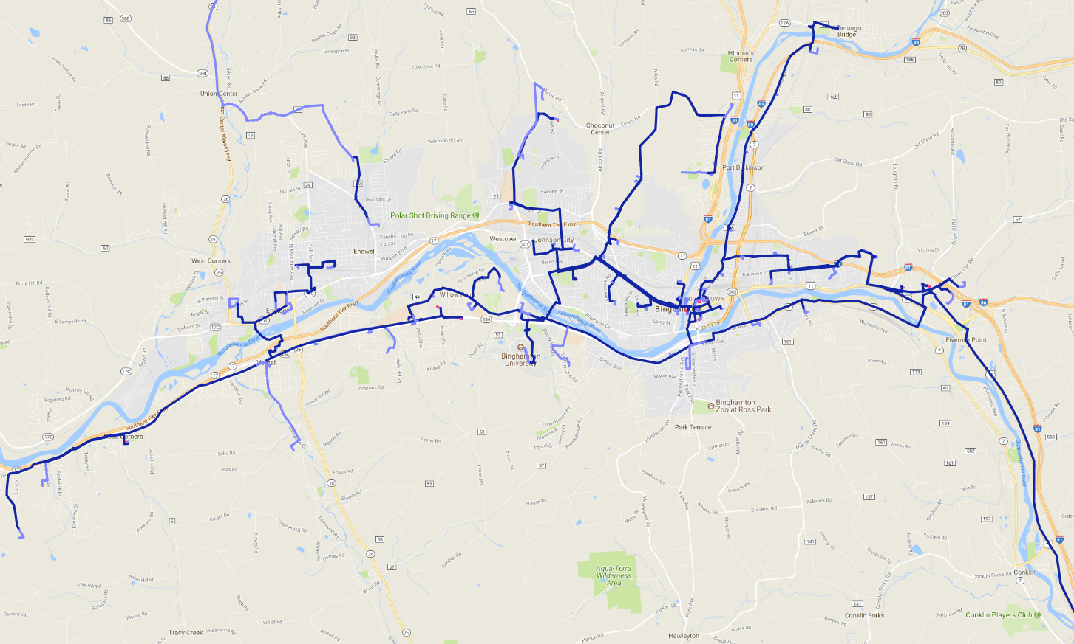
Binghamton, NY Network
Crown Castle Fiber is the premier provider of all-fiber, high-performance networking solutions delivered over our own network, enabling award-winning customer support and service reliability.
PROPRIETARY & CONFIDENTIAL

Slide 31
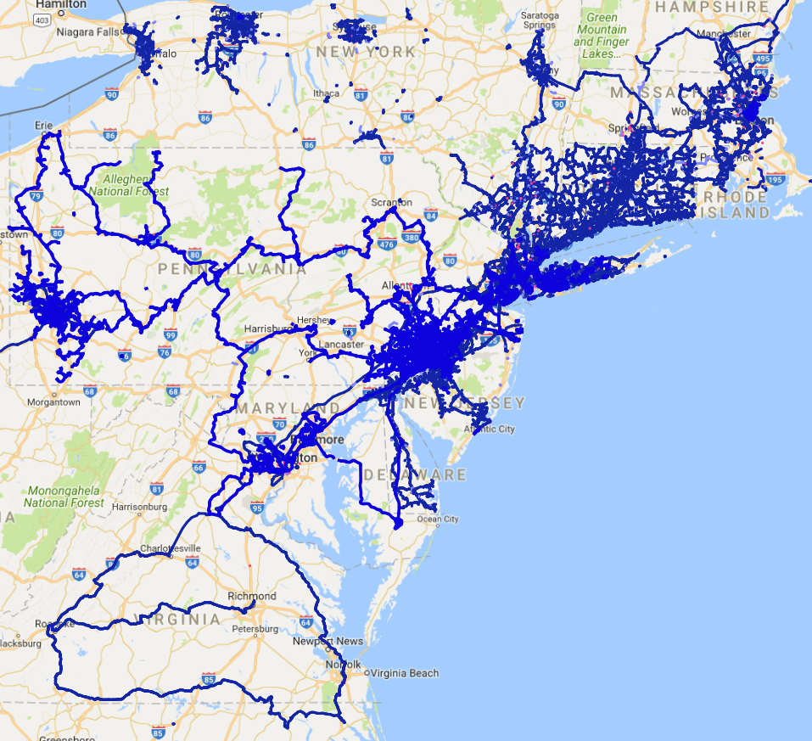
Northeast US Network
Crown Castle Fiber is the premier provider of all-fiber, high-performance networking solutions delivered over our own network, enabling award-winning customer support and service reliability.
PROPRIETARY & CONFIDENTIAL

